Slide 1
Professional React Development
copyright 2025, Chris Minnick
version 19.2.0,
April 2025
Notes:
Welcome to Professional React.js Web App Development

Slide 2

Introduction
Objectives
Who am I?
Who are you?
Daily Schedule
Course Schedule and Syllabus

Slide 3

About Me
Chris Minnick
Author of 20+ books, including React JS Foundations (Wiley, March 2022) and JavaScript All-In-One For Dummies (Wiley, May 2023)
20+ years experience in full-stack web development
Training & coding with React since 2015

Slide 4

Introductions
What's your name?
What do you do?
Where are you?
JavaScript level (beginner, intermediate, advanced)?
What do you want to know at the end of this course?
What do you do for fun?
Notes:
Please answer these questions!

Slide 5
The Big Picture
Some of the Topics Covered in this Course
React.js
Modern JavaScript
Testing
Backend integration
Redux
Error Handling
Advanced Topics
TypeScript
Best Practices
React Router

Slide 6
Course Repo and More Examples
github.com/chrisminnick/professional-reactjs
Here you'll find all the files you need to complete the labs, as well as the completed solutions for each lab.
https://reactjsfoundations.com
This is the website for ReactJS Foundations, by Chris Minnick (Wiley, March, 2022). It contains all the example code from the book, and more.

Slide 7
Daily Schedule
9:00 - 12:00: Lecture / Labs
Breaks on the hours (5-10 minutes)
1 hour lunch break
1:00 - 4:00: Lecture / Labs
Breaks on the hours
4:00 - 6:00 : labs and independent study

Slide 8
The Plan
Each day will be approximately 50% lecture and 50% labs
Monday: Introduction to React, Advanced JavaScript, JSX
Tuesday: React components, Props, Class vs. Function components, React State, Events
Wednesday: Forms, Component Lifecycle, Async code, AJAX, Hooks, PropTypes, TypeScript
Thursday: Testing, React Testing Library, Redux
Friday: Redux Middleware, Routing, Local Storage, Deploying, Advanced Topics

Slide 9
The Labs
Instructions: Professional-React-v19.2.2-labs.pdf
Time to complete labs vary between 15 mins and 1 hour+.
Let me know if something doesn't work.
If you finish a lab early:
try lab challenges,
help other students,
do additional reading,
take a break.

Slide 10
What is React.js?
Component-based
Library for building user interfaces
Notes:
React is more than just a library for building user interfaces. It's really a new way to think about building web applications. Once you understand the principles of it, it's surprisingly simple. React’s component-based one-way data flow makes it easy to reason about and easy to gradually refactor. This is one of the main things I want to demonstrate in this course -- it's very normal in React to start out with components that are poorly optimized and poorly designed and then to gradually make them better.

Slide 11

What is React NOT?
React is not a framework.
React is not a web server.
React is not a programming language.
React is not a database.
React is not a development environment.
React is not the solution to every problem.
Notes:
React itself is concerned only with the View -- the V in MVC. It doesn't have a data layer, so you'll need to bring in something else to handle operations such as Ajax.
At first, you may be surprised at how React seems to violate every rule of front-end development that we've created over the years -- React freely mixes display logic together with style and business logic for example. You'll see, however, that this mixing isn't what it appears to be, and it makes great sense and makes development of applications easy, and even fun.

Slide 12
When can you use React?
Complex single-page applications (SPAs) can be built entirely using React.
React can generate static HTML on the server.
React can be used to create native mobile apps.
Universal App (server side components + client side components)

Slide 13
React Quick Start
Objectives
Create a React App with Vite
Test and Run a React App

Slide 14
React with a Toolchain
Most Web Apps today are built using a set of tools that enable professional, team development.
The tools, collectively, are known as the JavaScript development toolchain.

Slide 15
What is Vite?
Creates JavaScript apps with no build configuration
Supports multiple libraries / frameworks
Simplifies setup of toolchain

Slide 16
Alternatives to Bootstrapping with Vite
Build your own toolchain
Install and configure a module bundler or compiler such as Webpack, ESbuild, or Parcel
Create React App
deprecated, but still works.
Next JS
a framework for full-stack React applications

Slide 17
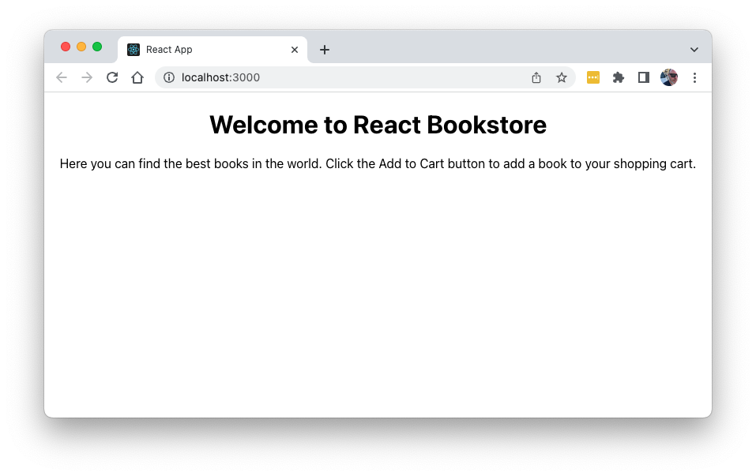
Lab 01: Get Started with Vite / React

Slide 18

Introduction to ReactJS
Objectives
Understand React
Explore the Virtual DOM
Explain one-way data binding
Create React Components
Manage state

Slide 19
What is React?
A JavaScript library for building user interfaces

Slide 20
React Philosophy
Thinking in Components
Composition vs. Inheritance
Declarative vs. Imperative
Idiomatic JavaScript

Slide 21
Thinking in Components
A component describes a piece of the UI
Each component returns an element
An element can be used in other components
A React UI is a tree of elements

Slide 22
Thinking in Components
A component should be an independent piece of the UI that can be reused.
Single Responsibility says that a component should only have one reason to change.

Slide 23
Composition vs. Inheritance
Inheritance uses parent classes to create more specific classes.
class WelcomeMessage extends Message
React favors creation of configurable and composable components instead.
class WelcomeMessage extends React.Component {
return (
<Message text="Welcome to my app!" />
)
}

Slide 24
Imperative vs. Declarative
Imperative
Focuses on the steps to complete a task
Example:
Walk to the stairs
Walk down stairs
Go to the kitchen
Open refrigerator
Take out salami, cheese, mustard
Put salami, cheese, mustard on bread
Declarative
Focuses on what to do without saying how
Bring me a sandwich.
Notes:
If you want to instruct your robot to make you a sandwich, there are two ways you can ask it. If your robot knows how to make a sandwich, you can use a declarative approach and simply say "Bring me a sandwich." The robot knows the steps it must do to bring you a sandwich and you don't car how the robot does it, as long as you get a sandwich. If the robot doesn't know how to make a sandwich, you can't use the declarative approach to requesting a sandwich. Instead, you'll need to give imperative instructions.

Slide 25
Imperative vs. Declarative Screen Updates
Imperative
getElementById(‘header’)
Declarative
render (
return <header>
Welcome to my App
</header>;
.innerHTML = “Welcome to my App”;
);

Slide 26
Idiomatic JavaScript
React is just JavaScript
React components are easily understandable to anyone who knows JavaScript.
If you know JavaScript, you can quickly start writing React.

Slide 27
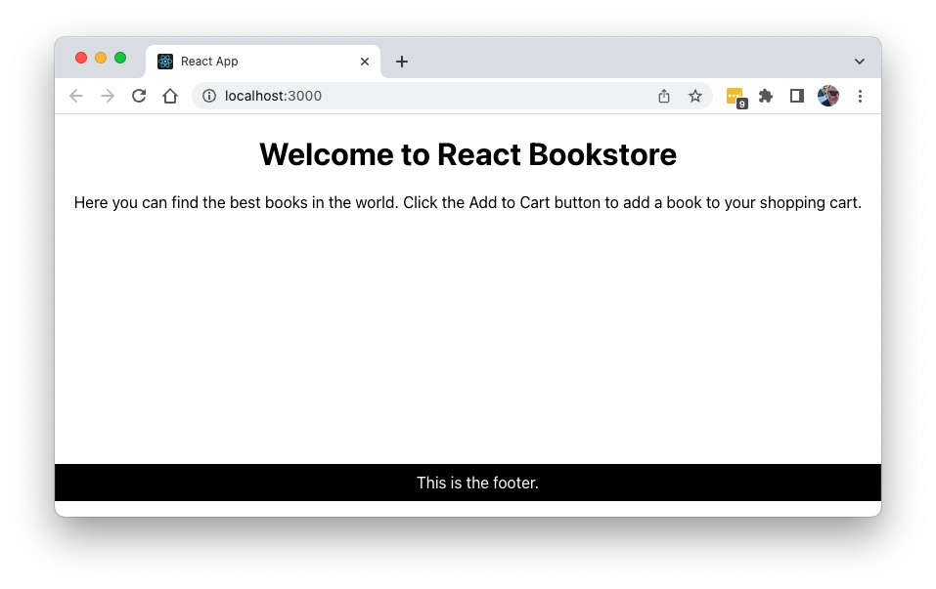
Lab 02: Your First Component

Slide 28
How React Works
Implements Web Components using JavaScript
Components are rendered using a Virtual DOM
State is stored in a “state” object
Updating a component’s state causes the component to re-render.
Updates to the Virtual DOM are applied to the actual DOM using the ReactDOM library’s render method.

Slide 29
Virtual DOM
Virtual DOM is updated (in memory) as the state of the data model changes.
React calculates the difference between the Virtual DOM and the real DOM.
React updates only what needs to be updated in the DOM.
Batches changes
Notes:
The virtual dom is what makes React performant. Without it, the browser DOM would update with each change, which would be pretty distracting. For example, imagine if the whole page refreshed each time you typed a letter into an input. This is what's happening in the virtual dom, but it happens in-memory and is very fast. The difference between this re-render of the virtual dom and the previous render of the virtual dom is calculated by React and the minimal changes to the browser DOM are made.

Slide 30
Virtual DOM vs. HTML DOM
Virtual DOM is a local and simplified copy of the HTML DOM
(It's an abstraction of an abstraction)
The goal of the Virtual DOM is to only re-render when the state changes.
This makes it more efficient than direct DOM manipulation.
Developers can write code as if the entire tree is being re-rendered.
This makes it easier to understand.
Behind the scenes, React/Virtual DOM works out the details and creates a patch for the HTML DOM, which causes the browser to re-render the changed part of the scene.

Slide 31
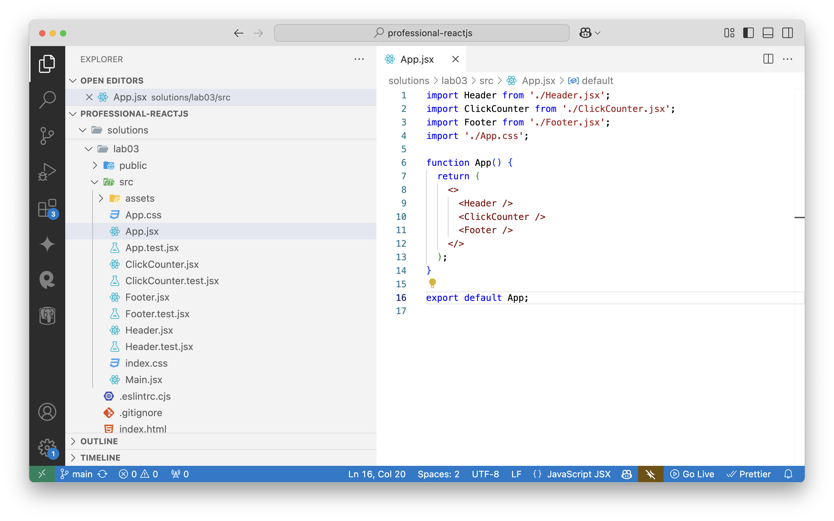
Lab 03: Create Tests and More Components

Slide 32
ReactDOM
Exported from react-dom package.
Provides methods that are used at the top-level of your app.

Slide 33
ReactDOM/client
Module for working with the Browser DOM
Methods
createRoot() - Creates a React root, which can be used to render a React element in the browser.
hydrateRoot() - Creates a React root from HTML rendered by ReactDOMServer

Slide 34
ReactDOM/server
Used for rendering React components on the server (in Node.js)
Methods
renderToStaticMarkup()
renderToString()
renderToReadableStream()
renderToPipeableStream()
renderToStaticNodeStream()

Slide 35
root.render()
import React from 'react';
import ReactDOM from 'react-dom/client';
import App from './App';
const container = document.getElementById('root’);
const root = ReactDOM.createRoot(container);
root.render(<App />);

Slide 36
Other Rendering Engines
React Native
Renders to native mobile apps
ReactDOM/server
Renders to static HTML
React Konsul
Renders to the browser console
react-pdf
Renders to PDF

Slide 37
Using JSX
Objectives
Write JSX
Use React with JSX

Slide 38
What is JSX?
A syntax extension to JavaScript
Allows you to put markup in JavaScript
Is not part of React, but it is used in most React codebases.

Slide 39
JSX is not HTML
XML syntax required
Elements must be closed
Attributes use DOM property names
className instead of class, htmlFor instead of for
React components start with upper-case
HTML elements start with lower-case
Attributes become props in the child

Slide 40
Components Return UI
A component can only return one thing.
string
number
array
Boolean
a single JSX element
undefined
As long as your elements are properly nested, the single element can have as many children as necessary.

Slide 41
Elements are Instances of Components
A component is a function or a class.
An element invokes the function or creates an instance of the class.

Slide 42
Two Types of Components
React DOM has built-in components that produce HTML
Examples: <div>, <p>, <h1>, <form>, <input>
HTML elements are always lowercase.
You create custom components
Custom components are upper camelcase.
May be made of HTML components and other custom components.
Examples: <LoginForm>, <WeatherChart>, <StockTicker>

Slide 43
Using React with JSX
function LoginBox(props){
return (
<div>
<label>Log In <input type="text" id="username"
placeholder={props.placeholderText} />
</label>
</div>
)
}
Notes:
When you use html tags in JSX, you're not actually writing HTML -- instead, you're instantiating React components that get rendered to HTML. For example, the div tags here are actually using the React div component.
You don't need to always return basic HTML. You can return a tree of components containing react components as well as HTML elements.
Inside the return statement, you can access props (and run any JavaScript) inside of curly braces. For example, to access the placeholderText prop passed into the component, you use {props.placeholderText}.

Slide 44
Using React without JSX
return(
React.createElement("div",null,
React.createElement("label",null,
"Log In",
React.createElement("input",
{ type: "text",
id: "username" }
)
)
)
);
Notes:
You can use plain JavaScript instead of JSX, although JSX syntax makes your views much easier to write and easier to visualize -- especially when nesting elements.

Slide 45
Using Literal JavaScript in JSX
Enclose JavaScript that shouldn't be interpreted as JSX in curly braces
Object literals must be in double curly braces
Enclose comments in curly braces
Literal JS in JSX must be an expression.
Expressions resolve to a value.
Not an expression: function doSomething(){...}
Is an expression: doSomething()

Slide 46
Literal JS in JSX
return (
<p>Welcome, {props.firstName}.
Today is
{new Date().toLocaleDateString()}
</p>
);

Slide 47
Conditional Rendering with JSX
Three Methods
With Element Variables
With &&
With the conditional operator

Slide 48
Conditional Rendering with Element Variables
function Welcome({loggedIn}) { let header;
if (loggedIn) {
header = <Header />;
} else {
header = <Login />;
}
return ( <div> {header} </div> ) } export default Welcome;
Notes:
https://www.reactjsfoundations.com/listing309

Slide 49
Conditional Rendering with the && Logical Operator
function Welcome({loggedIn}){
return (
<div> {loggedIn&&<Header />}
Note: if you don't see the
welcome messsage, you're not
logged in. </div>
)
}
export default Welcome;
Notes:
https://www.reactjsfoundations.com/listing310

Slide 50
Conditional Rendering with the Conditional Operator
function Welcome({loggedIn}){
return(
<div>
{loggedIn?<Header />:<Login />}
</div>
)
}
export default Welcome;
Notes:
https://www.reactjsfoundations.com/listing311

Slide 51
React.Fragment
The single-element return rule in React can create unnecessary elements in the browser.
React.Fragment can be used to wrap multiple elements without rendering an element.
return(
<React.Fragment>
<h1>The heading</h1>
<h2>The subheading</h2>
</React.Fragment>
)

Slide 52
React.Fragment Shorthand
You can use <> ... </> as a shorthand for React.Fragment.
function MyComponent(){
return(
<>
<h1>The heading</h1>
<h2>The subheading</h2>
</>
);
}
export default MyComponent;

Slide 53
HTML element attributes
React DOM supports all HTML attributes on built in HTML elements.
A few are renamed.
Multi-word attributes are lower camelCase
Example:
<div id="companyLogo" className="companyLogo"> <img src="/images/logo.png" height="100" width="200" alt="Our company logo" /> </div>

Slide 54
props in Custom Components
Props are passed from the parent component to its children
JSX attributes are passed to the child as properties of an object.
Parent: <Hello name="Chris" />
Class Child:
function Hello(props){
return (<h1>Hello, {props.name}</h1>);
}

Slide 55
props.children
Automatically passed in props object.
Returns the child elements of a React element.
Makes composition of elements possible.
<BorderBox>
<p>The first paragraph.</p>
<p>The second paragraph.</p>
</BorderBox>
function BorderBox(props){
return(<div style={{border:"1px solid black"}}>
{props.children}
</div>);
}

Slide 56
React Development Process
Step 1: Break The UI Into A Component Hierarchy
Step 2: Build A Static Version in React
Step 3: Identify The Minimal (but complete) Representation Of UI State
Step 4: Identify Where Your State Should Live
Step 5: Add Inverse Data Flow
Step 1: Break The UI Into A Component Hierarchy

Slide 57
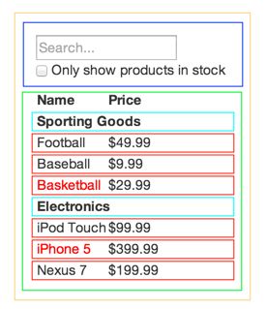
Creating a Component Hierarchy
How do you know what should be a component?

Slide 58
React Development Process
Step 1: Break The UI Into A Component Hierarchy
Step 2: Build A Static Version in React
Step 3: Identify The Minimal (but complete) Representation Of UI State
Step 4: Identify Where Your State Should Live
Step 5: Add Inverse Data Flow
Step 2: Build A Static Version in React

Slide 59
Goals of a Static Version
Render the UI with no interactivity
Create a library of reusable components that render the data model
function ProductCategoryRow(){
return (
<tr>
<th colSpan="2">
test data
</th>
</tr>
);
};
export default ProductCategoryRow;

Slide 60
Lab 04: Static Version

Slide 61
Advanced JavaScript for React
Objectives
Use arrow functions and block-scoped variables
Use classes and modules
Understanding ‘this’

Slide 62
Variable Scoping with const and let
const creates constants
Immutable and block-scoped
Cannot be reassigned new content
The assigned content isn't immutable, however,
If you assign an object or array to a constant, the properties or elements of the variable can be changed.
let creates block-scoped variables
Main difference between let and var is that the scope of var is the entire enclosing function.
Redeclaring a variable with let raises a syntax error
Unlike with var, variables created with const and let aren't hoisted.
You can't reference a variable before its declaration.
Notes:
The first new things in ES6 that we'll be talking about are const and let. Unlike variables defined using the var keyword, these new es6 keywords create block-scoped variables. They have some other important differences as well.
Const creates immutable variables -- that is, once you assign a value to a const, the value can't be changed.
Let creates block-scoped variables (variables that are private to their enclosing curly braces, as opposed to having function scope as JavaScript up to this point

Slide 63
let vs. var
var
let
var a = 5;
var b = 10;
if (a===5) {
var a = 4;
var b = 1;
}
console.log(a); //4
console.log(b); //1
let a = 5;
let b = 10;
if (a===5) {
let a = 4;
let b = 1;
}
console.log(a); //5
console.log(b); //10
Notes:
Here's an example that demonstrates the difference between scoping with let and var.

Slide 64
Arrow Functions
Compact alternative to function expressions.
(params) => {expression}
Doesn't have its own this
Lexical scope – this refers to the enclosing scope
Should not be used as methods.
Can't be used for constructor functions
Can't be used with call, apply, or bind
Are always anonymous function expressions.

Slide 65
Arrow Functions – basic example
const sum = (num1,num2) => {
return num1 + num2;
}

Slide 66
Arrow Functions (cont.)
Parentheses around parameters are optional if there's only one param.
const sum = numbers => {
return numbers.reduce((sum,current)=>sum+current);
}
return keyword and curly braces are optional if the function only returns data.
const sum = numbers =>
numbers.reduce(
(sum,current)=>sum+current
);
Notes:
Arrow functions are always anonymous functions, meaning the only way to assign a name to them is to assign the function to a variable. Arrow functions also handle the this keyword more intuitively, which eliminates the need for the hack shown here in order to refer to the object that a function is inside.

Slide 67
Default Parameter Handling
OLD
function f (x, y, z) {
if (y === undefined)
y = 0;
if (z === undefined)
z = 13;
return x + y + z;
};
NEW
function myFunc (x, y = 0, z = 13) {
return x + y + z;
}

Slide 68
Rest Parameter
Aggregation of remaining arguments into single parameter of variadic functions.
function myFunc (x, y, ...a) {
return (x + y) * a.length;
}
console.log(myFunc(1, 2, "hello", true, 7));
http://jsbin.com/pisupa/edit?js,console

Slide 69
Spread Operator
Spreading of elements of an iterable collection (like an array or a string) into both literal elements and individual function parameters.
let params = [ "hello", true, 7 ];
let other = [ 1, 2, ...params ];
console.log(other); // [1, 2, "hello", true, 7]
console.log(MyFunc(1, 2, ...params));
let str = "foo";
let chars = [ ...str ]; // [ "f", "o", "o" ]
http://jsbin.com/guxika/edit?js,console

Slide 70
Template Literals
String Interpolation
let customer = { name: "Penny" }
let order = { price: 4, product: "parts", quantity: 6 }
message = `Hi, ${customer.name}. Thank you for your order of ${order.quantity} ${order.product} at ${order.price}.`;
http://jsbin.com/pusako/edit?js,console
Notes:
Template literals are enclosed by the back-tick (` `) (grave accent) character instead of double or single quotes.

Slide 71
Method notation in object property definitions
const shoppingCart =
{
itemsInCart: [],
addToCart (id) {
this.itemsInCart.push(id);
},
};

Slide 72
Array Destructuring
Intuitive and flexible destructuring of Arrays into individual variables during assignment
const list = [ 1, 2, 3 ];
let [ a, , b ] = list; // a = 1 , b = 3
[ b, a ] = [ a, b ];
http://jsbin.com/yafage/edit?js,console

Slide 73
Object Destructuring
Flexible destructuring of Objects into individual variables during assignment
let { a, b, c} = {a:1, b:2, c:3};
console.log(a); // 1
console.log(b); // 2
console.log(c); // 3
http://jsbin.com/kuvizu/edit?js,console

Slide 74
Array.map()
Array.map()
Creates a new array with the results of calling a provided function on every element in this array.
Syntax
const newarray = arr.map(arrayElement => arrayElement + 1);
Parameters passed to the callback
currentValue
The current element being processed
index
The index (number) of the current element
array
The array map was called upon

Slide 75
Array.filter()
Array.filter()
Creates a new array with the results of a test.
Syntax
let new_array = arr.filter(test)
Example
const customersNamedBill = customerNames.filter(name=>name === "Bill");

Slide 76
Array.reduce()
Array.reduce()
Executes a reducer function on each element of an array.
Syntax
let value =
arr.reduce((previous,current)=>previous + current,initValue);
Example
let orderTotal = items.reduce((total,item) => total + item.price,0);

Slide 77

References, Shallow, and Deep Copies
JavaScript arrays and objects are reference values
If you use the assignment operator you create a reference. The new name references the same object. let arr = ['red','green','blue']; let newArr = arr; newArr.push('orange'); arr > ['red','green','blue','orange']

Slide 78
Shallow Copy an Array
A shallow copy is an array created by copying each element of the original array to the new array.
Can be done in several ways:
Using a loop for (i = 0; i < numbers.length; i++) { numbersCopy[i] = numbers[i]; }
Using the slice method numbersCopy = numbers.slice();
Using the spread operator numbersCopy = [...numbers];

Slide 79
Shallow Copy an Object
A shallow copy is an array created by copying each property of the original object to the new object.
Primitive properties are separate from the original object
Object properties are references to the original
Can be done using spread operator:
let person = { foo: 'bar', x: 0 };
let p1 = { ...person };
Or by using object.assign:
let p2 = Object.assign({}, person);

Slide 80
Chapter 5: Modularity
Objectives
Explain modularity
Learn different methods of using modules in JS
Understand methods of front-end module management

Slide 81
Why is Modularity Important?
Individual modules can be tested
Allows distributed development
Enables code reuse
Reduce coupling
Increase cohesion

Slide 82
CommonJS
export an anonymous function
hello.js
module.exports = function () {
console.log("hello!");
}
app.js
let hello = require("./hello.js");
export a named function
hello.js
exports.hello = function () {
console.log("hello!");
}
app.js
let hello = require("./hello.js").hello;
Modularity for JavaScript outside of the browser
Node.js is a CommonJS module implementation
uses require to include modules

Slide 83

RequireJS
File and module loader for in-browser use
Can also be used in other environments (like Node)
Uses Asynchronous Module Loading (AMD)
index.html
<script data-main="scripts/main" src="scripts/require.js">
</script>
main.js
require(["purchase"],
function(purchase){
purchase.purchaseProduct();
});
purchase.js
define(["credits","products"], function(credits,products) {
return {
purchaseProduct: function() {
…

Slide 84
ES Modules
Named export
lib.js
export function square(x) {
return x * x;
}
main.js
import {square} from 'lib';
Default export
myFunc.js
export default function() {
…
};
main.js
import myFunc from ‘./myFunc';
2 Types
named exports
multiple per module
default exports
1 per module

Slide 85
The Document Object Model
Objectives
Understand how the DOM works
Select DOM nodes
Manipulate the DOM with JavaScript

Slide 86
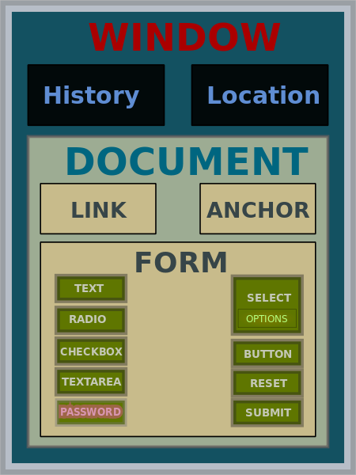
What is the DOM?
JavaScript API for HTML documents
Represents elements as a tree structure
Objects in the tree can be addressed and manipulated using methods.
JohnManuel [GFDL (http://www.gnu.org/copyleft/fdl.html) or
CC BY-SA 3.0 (http://creativecommons.org/licenses/by-sa/3.0)],
via Wikimedia Commons

Slide 87
Understanding Nodes
DOM interfaces that inherit from Node
Document
Element
CharacterData
Text
Comment
DocumentType
Nodes inherit properties from EventTarget

Slide 88
EventTarget
An interface implemented by objects that can receive events (aka event targets)
Examples:
Element
Document
Window
Many event targets support setting event handlers.

Slide 89
DOM Events
Things that happen in the DOM
abort
beforeinput
blur
click
compositionend
compositionupdate
dblclick
error
focus
focusin
focusout
input
keydown
keyup
load
mousedown
mouseenter
mouseleave
mousemove
mouseout
mouseover
mouseup
resize
scroll
select
unload
wheel

Slide 90
Element
Interface for elements within a Document
Inherits properties and methods from Node and EventTarget
Most common properties:
innerHTML
attributes
classList
id
tagName
Most common methods
getElementById
addEventListener
querySelectorAll

Slide 91
Manipulating HTML with the DOM
You can get and set properties of HTML elements with JavaScript through the DOM
//starting HTML and DOM Element
<p id="favoriteMovie">The Matrix</p>
<script>
getElementById("favoriteMovie")
.innerHTML = "The Godfather";
</script>
//updates DOM, which updates the browser
<p id="favoriteMovie">The Godfather</p>

Slide 92
Manipulating HTML with the DOM (cont.)
<ol id="favoriteSongs">
<li class="song"></li>
<li class="song"></li>
<li class="song"></li>
</ol>
<script>
let mySongs=document
.querySelectorAll("#favoriteSongs .song");
mySongs[0].innerHTML = "My New Favorite Song";
</script>

Slide 93
Manipulating HTML with JQuery
<ol id="favoriteSongs">
<li class="song"></li>
<li class="song"></li>
<li class="song"></li>
</ol>
<script>
$("#favoriteSongs .song").first()
.html("My New Favorite Song");
</script>

Slide 94
Manipulating HTML with React
function ThingsILike() {
return (
<FavoriteSongs songList = {[”song1”,”song2”,”song3”]) />
);
}
function FavoriteSongs(props) {
return (
<ol>
{props.songList.map(song => <li>{song}</li>)}
</ol>
);
}

Slide 95
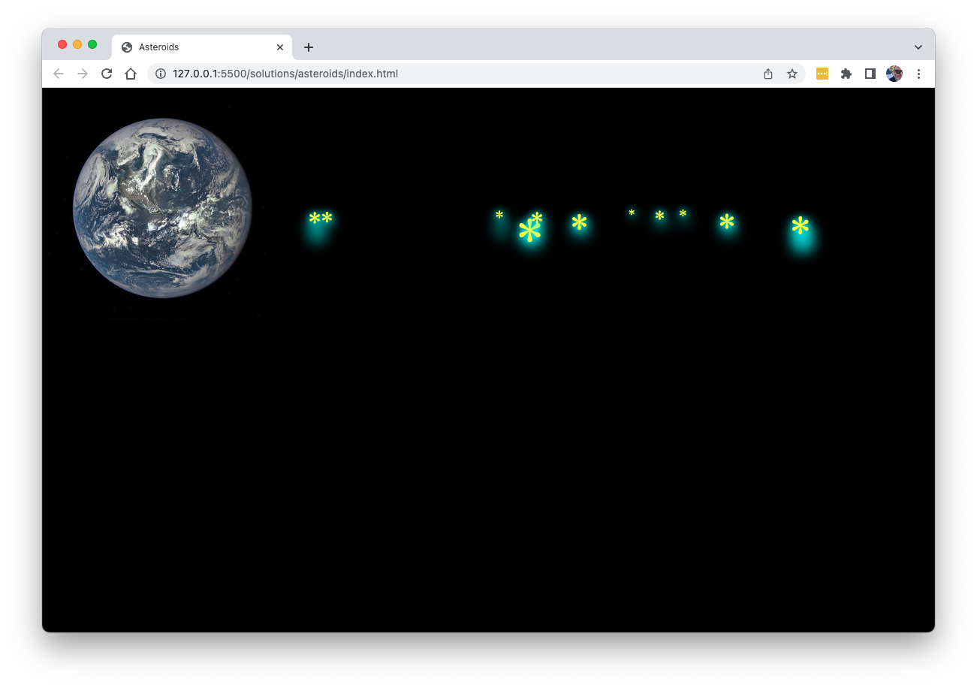
Lab 5: DOM Manipulation and Modern JavaScript

Slide 96
Styles in React

Slide 97
Two Approaches to Style
Use CSS
Import CSS files
Use a CSS library (Bootstrap for example)
Use CSS Modules
Use JavaScript
Inline styles
Style modules

Slide 98
Importing CSS
If your module bundler is configured to bundle CSS files (Create React App does this by default), you can simply import CSS into a component.
import "styles.css";
function MyComponent(props){
return (
<div className="article-link">
<h1 className="title">
{props.title}</h1> </div> );
}
export default ArticleLink;

Slide 99
CSS Modules
Importing CSS creates global styles.
A CSS Module is a CSS file with class names scoped locally by default.
Is supported by Create React App
CSS Modules must be named using [name].modules.css
Can be imported as JS
import styles from './MyStyles.module.css';
Can be used with dot notation
return <button className={styles.warning}>Warning</button>

Slide 100
Inline Styles
The style attribute on React's built-in elements will apply styles in the DOM using JavaScript
function WarningMessage(props){
return (
<p style={{ color:"red", padding:"6px", backgroundColor:"#000000"}}>
{props.warningMessage}
</p> );
}

Slide 101
Style Objects
Assign a style object to a variable to make it more reusable.
function WarningMessage(props){
const textColors = {
warning:{color:"red", padding:"6px", backgroundColor:"#000000"}
};
return (
<p style={textColors.warning}>
{props.warningMessage}
</p> );
}

Slide 102
Style Modules
Export style objects to create a library of reusable styles.
export const warningStyle = {color:"red",padding:"6px",backgroundColor:"#000000"};
export const infoStyle = {color:"yellow",padding:"6px",backgroundColor:"#000000"};
export const successStyle = {color:"yellow",padding:"6px",backgroundColor:"#000000"};

Slide 103
CSS-in-JS
There are MANY different CSS-in-JS libraries available.
Most support Scoped CSS, Server-side Rendering, Automatic vendor prefixing, and more.
Examples include:
styled-components
Emotion
Goober
Compiled
Fela
JSS
Treat
Styled JSX

Slide 104
Styled Components
import styled from 'styled-components';
Call styled.[object] function, passing in style info using Tagged Template Literal Notation.
const Title = styled.h1`
font-size: 1.5em;
text-align: center;
color: palevioletred;
`;
<Title>This is a styled component</Title>

Slide 105
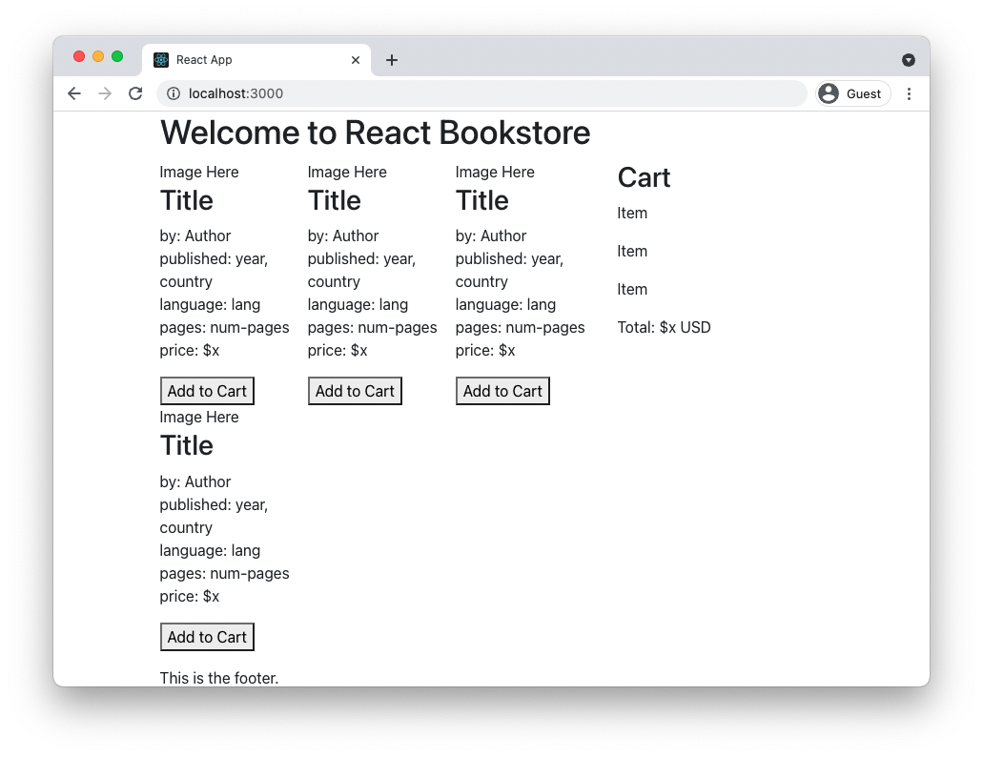
Lab 06: Styling React

Slide 106
Data Flow

Slide 107
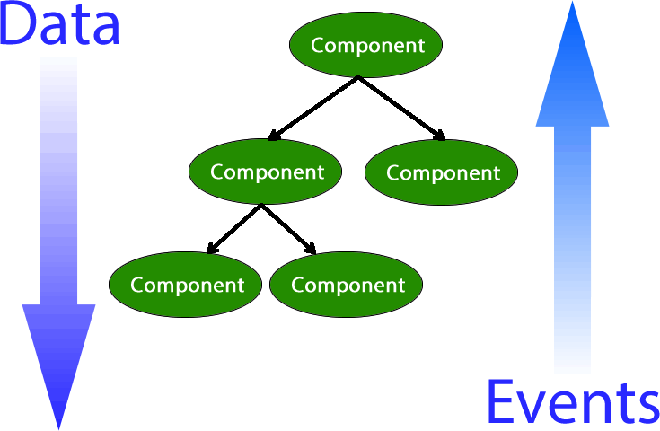
One-way Data Flow
Each UI element represents one component
All data flows from owner to child
Notes:
React takes a different approach to updating the UI than other libraries and frameworks. Traditionally, the way we implement a dynamic UI is to use two-way binding. In two-way binding, changes to the state of the user interface components (html) trigger changes in the model and vice-versa.
In one-way data flow (aka one-way data binding), as implemented by React, the only way to update the user interface is by using the render() function. In other words, typing into an input field in a React application doesn't actually do anything to the input field. It triggers a function in a component which causes the browser to be updated and the text to appear in the input field.
The benefit of one-way data flow is that it makes it much easier to understand what's going on in your applications. You can think of every change to the user interface as being a complete refresh of the browser window, even though this isn't necessary because of React's Virtual DOM.

Slide 108
Props vs. State
Props
State
Passed to a component instance using JSX attributes
Immutable
Better performance
Internal data of a component instance
State of the parent can be passed to child components as props.
Mutable
Notes:
You can think of props as options passed to components. Components should never modify props.
Instead, state should be modified and passed to child components, where it becomes props.
State should never be accessed by child components.
Most components should simply take data from props and render it.
In a well-designed app, you should have more stateless components than stateful ones.

Slide 109
Communication Between Components
Parent to Child
pass props
Child to Parent
Callback Functions
Parent passes a function to a child
<MyChild myFunc={handleChildFunc} />
Child calls the function
props.myFunc();

Slide 110
Communication Between Components (cont.)
Between Siblings
Use a parent component.
Any to Any
Observer Patterns
Components subscribe to messages.
Other components publish messages to subscribers.
Context
Provides data to an entire subtree

Slide 111
Container (aka Page) Components
Wrap presentational components
Contain the logic and state
Correspond to pages
Examples:
HomePage
ServicesPage

Slide 112
Presentational Components
Components that just output presentation
Contain no logic
Responsible for generating UI elements
Display data passed by Pages

Slide 113
Folder Structure
Organize projects by Feature
Keep Pages and Presentational components separate
- /pages
- /pages/App.jsx
- /pages/ShoppingCart.jsx
- /pages/ShoppingCart.css
- /components
- /components/Header.jsx
- /components/ProductInfo.jsx
/services
/services/api.js
/context
/hooks
/index.jsx

Slide 114
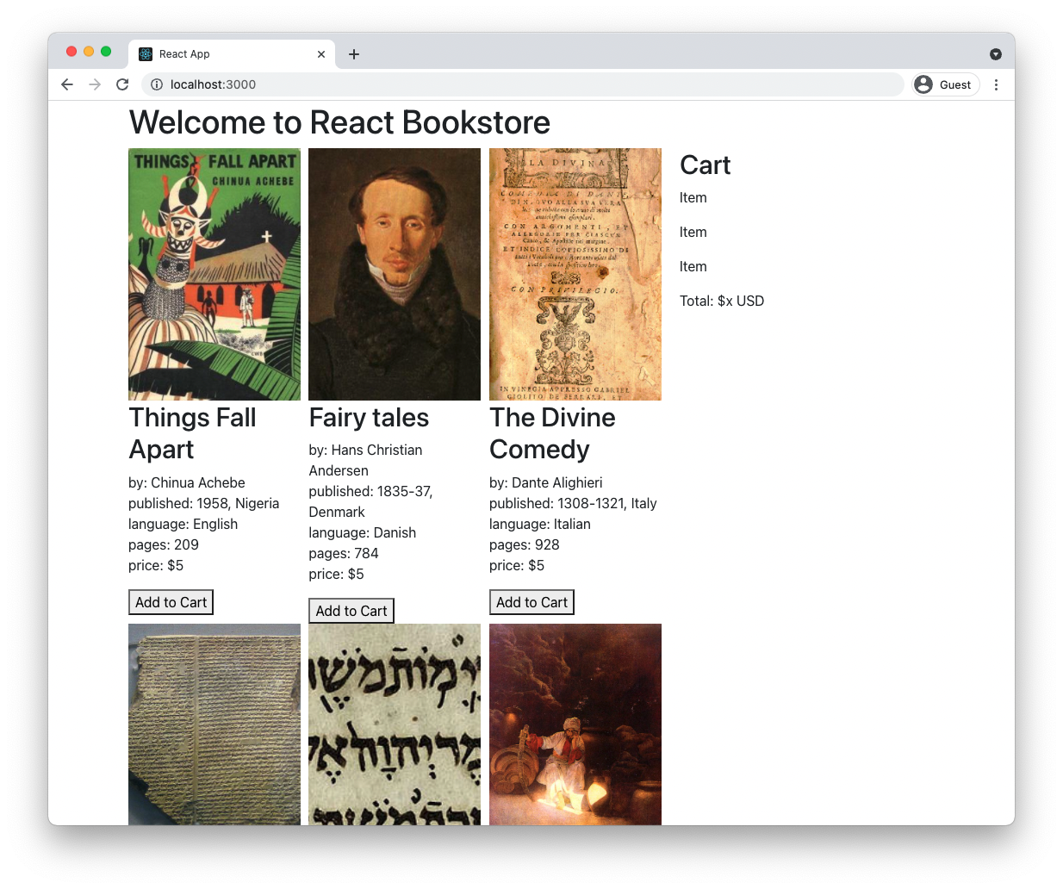
Lab 07: Props and Containers (aka Pages)

Slide 115
State

Slide 116
React Development Process
Step 1: Break The UI Into A Component Hierarchy
Step 2: Build A Static Version in React
Step 3: Identify The Minimal (but complete) Representation Of UI State
Step 4: Identify Where Your State Should Live
Step 5: Add Inverse Data Flow
Step 3:
Identify The Minimal (but complete) Representation Of UI State

Slide 117
What is State?
The INTERNAL data that influences the output of a component instance.

Slide 118
How State Affects render()
The state object can only be changed using a state setting function. This method modifies the state object and then causes the component to render.

Slide 119
How to Know if it Should Be State
Is it state?
Is it passed from the parent via props?
Probably not state
Does it change over time?
Might be state
Can you compute it based on any other state or props in your application?
Probably not state

Slide 120
Setting Initial State
In Class Components:
class MyComponent extends React.Component {
constructor() {
this.state = { /* some initial state */ }
}
In Function Components:
useState Hook returns a stateful variable and a function for setting it.
Argument passed to useState is the initial value of the variable.
function MyComponent(){
const [myState, setmyState] = useState("hi!");
}
Notes:
The constructor function runs when a class is instantiated. Therefore, this is the place where we can initialize the state for a component. Generally, you'll only set the initial state in one component, typically the highest level (or container) component. When this state object changes, it will cause ReactDOM to re-render the component (and it's children) in the virtual DOM and then calculate the updates that are required in the browser DOM and make them.

Slide 121
Updating State
in Class Components
setState()
Takes an object and merges the object into the state object.
in Function Components
setter function returned by useState
replaces current value with argument

Slide 122
setState
Function for updating a class component's state outside of the constructor.
Takes an object or a function as its argument and uses the argument to schedule an update to the state.
setState is asynchronous

Slide 123
setState with an Object
The object will be merged with the current state.

Slide 124
setState with a Function
The function receives the state and props of the component and returns an object.
The object will be merged with the current state.
Use a function when the new state depends on the current state.

Slide 125
useState setter function
The 2nd element of the array returned by the useState hook is a function for updating the state variable (the first element returned by the hook).
Unlike setState in class components, the updater function returned by useState does not merge the new state, it replaces the old state with the new state.

Slide 126
Valid arguments
You can pass any value or a function to a setter function.
If the new state depends on the old state, pass a function to the setter function.

Slide 127
What to Put in State
Properties of a component that can change over time.

Slide 128
What Not to Put in State
Anything that can be calculated.
Anything passed down from a parent component.

Slide 129
React Development Process
Step 1: Break The UI Into A Component Hierarchy
Step 2: Build A Static Version in React
Step 3: Identify The Minimal (but complete) Representation Of UI State
Step 4: Identify Where Your State Should Live
Step 5: Add Inverse Data Flow
Step 4:
Identify Where Your State Should Live

Slide 130
Where Should Your State Live?
For each piece of state:
Identify every component that renders something based on that state.
Find a common owner component
The common owner or a component higher in the hierarchy should own the state.
If you can't find a common owner, create a new component higher up in the hierarchy just for holding the state.

Slide 131

Lab 08: Adding State

Slide 132
Events

Slide 133
SyntheticEvent
A cross-browser wrapper around the browser's native event
Hides the implementation details of how React events translate to DOM events
Contains the same properties as native events, along with some React-specific ones.

Slide 134
Event Listener Attributes
React's built-in components support HTML-style event listener attributes.
There are some differences between how to use these in React and how they're used in HTML
React event listener attributes use camelCase
onSubmit
onClick
onChange

Slide 135
The Event Object
React events create a SytheticBaseEvent object
SyntheticBaseEvent has a property called NativeEvent, which contains the properties of the native DOM event.
You can use SyntheticBaseEvent the same as you the native Event object in JavaScript without React.
SyntheticBaseEvent is passed to the callback function when an event happens.

Slide 136
Event Handler Functions
Unlike HTML event listeners, which take a function call, React event handlers take a function name or a function.
HTML
<button onclick="handleChange()">Click Me</button>
React (JSX)
<button onClick={handlechange}>Click Me</button>
The function will be called, and the Synthetic Event will be passed to it, when the event happens.

Slide 137
Binding Event Handlers
When you pass a function from a class component to another component, you need to bind the function to the parent class to provide the correct context for the this keyword.
Only necessary when using method notation or the function keyword in class components.
Arrow functions are automatically bound to the object where they're created.
Function components don't have an instance (no this), so no binding inner functions.

Slide 138
Passing Data to Event Handlers
Many times, the event object contains all the data you need for the event handler function, so there's no need to explicitly pass arguments.
handleEvent(e){
this.setState({firstName:e.target.value});
}
<input type="text" onChange={handleEvent} />
If you want to pass data to an event handler, one way is to use an arrow function as the value of the listener.
<input type="text"
onChange={(e)=>updateName(e.target.value)} />

Slide 139
Important Event Properties
Event.cancelable indicates whether an event can be canceled.
Event.target references the object onto which the event was originally dispatched (such as an element that was clicked or a form input that was typed into).
Event.type contains the name of the event, such as click, change, load, mouseover, and so forth.
Event.preventDefault cancels an event if it’s cancelable.

Slide 140
Forms
Objectives
Use Controlled Components
Use Uncontrolled Components

Slide 141
React Development Process
Step 1: Break The UI Into A Component Hierarchy
Step 2: Build A Static Version in React
Step 3: Identify The Minimal (but complete) Representation Of UI State
Step 4: Identify Where Your State Should Live
Step 5: Add Inverse Data Flow
Step 5:
Add Inverse Data Flow

Slide 142
What is "Inverse Data Flow"?
Use a function to update state in components higher up in the hierarchy.

Slide 143
Forms Have State
They are different from other native components because they can be mutated based on user interactions.
Properties of Form components
value
supported by <input> and <textarea>
checked
supported by <input type="checkbox | radio" />
selected
supported by <option>
<textarea> should be set with value attribute, rather than children in React

Slide 144
Form Events
Form components allow listening for changes using onChange
The onChange prop fires when:
The value of <input> or <textarea> changes.
The checked state of <input> changes.
The selected state of <option> changes.

Slide 145
Controlled Inputs
A controlled <input> is one with a value prop.
User input has no effect on the rendered element.
To update the value in response to user input, you can use the onChange event.
Controlled vs. Uncontrolled Demo:
https://codesandbox.io/s/controlled-vs-uncontrolled-0f1esu

Slide 146
Uncontrolled Components
An <input> without a value property is an uncontrolled component.
render() {
return <input type="text" />;
}
User input will be reflected immediately by the rendered element.
Maintains its own internal state

Slide 147
Preventing Default Actions
Use Event.preventDefault to prevent an element's default action from happening.
Commonly used with forms to prevent submitting from trying to load a separate page.
handleSubmit(e){ e.preventDefault();
// do something here
}

Slide 148
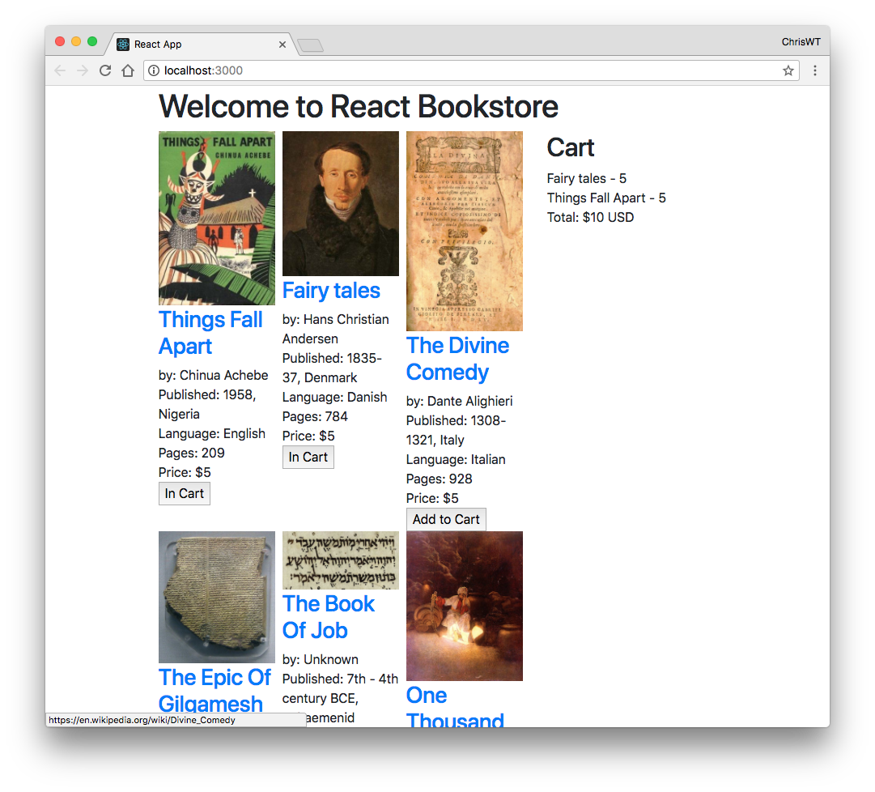
Lab 09: Interactions, Events, Callbacks

Slide 149
Component Life-Cycle Events
Categories
Mount
Updating
Unmounting
Error handling

Slide 150
Life-Cycle Methods
Methods of components that allow you to hook into views when specific conditions happen.

Slide 151
Mount/Unmount
Mount and unmount methods are called when components are added to the DOM (Mount) and removed from the DOM (Unmount).
Each is invoked only once in the lifecycle of the component
Used for:
establish default props
set initial state
make AJAX request to fetch data for component
set up listeners
remove listeners

Slide 152
Mount/Unmount Lifecycle Methods
constructor
static getDerivedStateFromProps
checks whether props have changed and uses new props to update state
render
componentDidMount
componentWillUnmount

Slide 153
Updating Lifecycle Methods
static getDerivedStateFromProps
shouldComponentUpdate
returns a Boolean, which determines whether updating will happen.
getSnapshotBeforeUpdate
use for capturing information about the state before updating
render
componentDidUpdate

Slide 154
Error Handling Methods
getDerivedStateFromError
Runs when an error happens in a descendant component.
Receives the error that occurred and can return an object for updating the state.
componentDidCatch
Runs after a descendant component throws an error.
Useful for logging errors.

Slide 155
What is an error boundary?
Error boundaries use the getDerivedStateFromError and/or componentDidCatch lifecycle methods to catch and handle errors in a component’s children.
Can be used to keep an error in a child component from crashing the entire UI
Can also be used for logging the error

Slide 156
Implementing Error Boundaries
class ErrorBoundary extends React.Component { constructor(props) { super(props); this.state = { hasError: false }; } static getDerivedStateFromError(error) { return { hasError: true }; }
componentDidCatch(error, errorInfo) {
logErrorToMyService(error, errorInfo);
}
render() {
if (this.state.hasError) {
return <h1>Something went wrong.</h1>;
}
return this.props.children; }
}

Slide 157
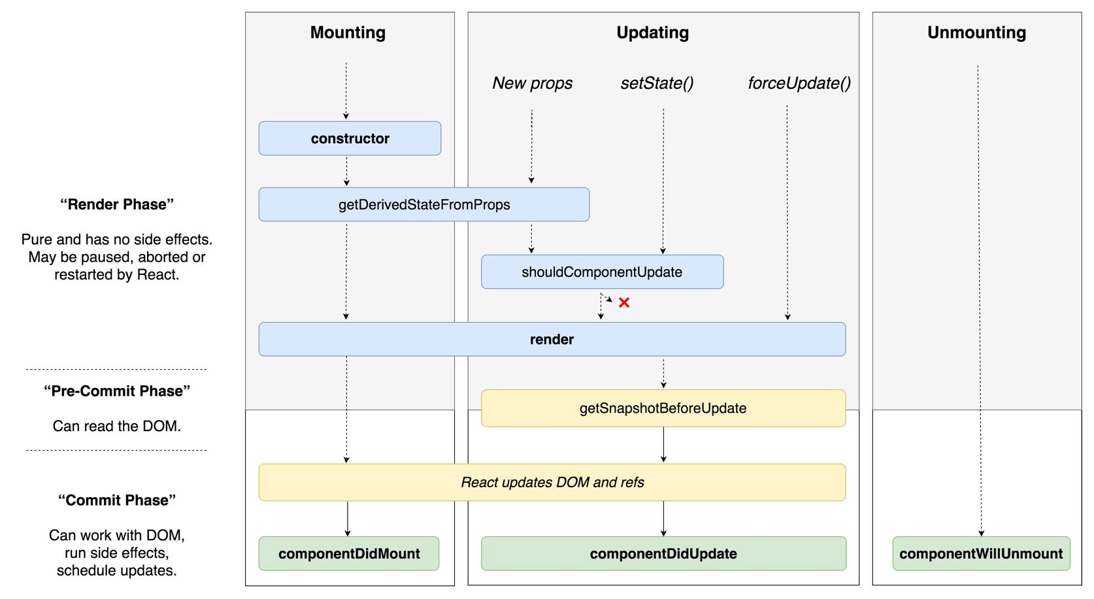
Component Life Cycle

Slide 158
React Components
Objectives
Understanding components and elements
Understand how to write components
Understand component life-cycle
Use events and event handlers
Communicate between components

Slide 159

What are components?
React components define React Elements
Elements are composed to create UI

Slide 160
Creating Components
Two techniques
Extend React.Component
Function Component

Slide 161
Class Definition
ES6 introduces more OOP-style classes
Can be created with Class declaration or Class expression

Slide 162
Class Declaration
class Square {
constructor (height, width) {
this.height = height;
this.width = width;
}
}

Slide 163
Class Expressions
Can be unnamed
const Square = class {
constructor(height,width) {
this.height = height;
this.width = width;
}
};
Or named
class Square {
constructor(height, width) {
this.height = height;
this.width = width;
}
};

Slide 164
Class Inheritance
class Rectangle extends Shape {
constructor (id, x, y, width, height) {
super (id, x, y);
this.width = width;
this.height = height;
}
}
class Circle extends Shape {
constructor (id, x, y, radius) {
super (id, x, y);
this.radius = radius;
}
}

Slide 165
Private Methods
Methods of an object can be private to that object.
Private methods can only be used within the object.
To define private methods in classes or objects, preface the name of the object with #.
class Customer {
#getFullName() {
return `${this.fname} ${this.lname}`
}
greetCustomer() {
return `Welcome, ${#getFullName()}`;
}
}

Slide 166
Static methods
Static methods are methods that are called on the class, rather than on an instance of the class.
Generally used for utilities.
class Customer {
static getActiveCustomers(){
// return active customers
}
}
Customer.getActiveCustomers();

Slide 167
Understanding this
Allows functions to be reused with different context.
Which object should be focal when invoking a function.

Slide 168
4 Rules of this
Implicit Binding
Explicit Binding
New Binding
Window Binding

Slide 169
What is this?
When was function invoked?
We don't know what this is until the function is invoked.

Slide 170
Implicit Binding
this refers to the object to the left of the dot.
const author = {
name: 'Chris',
homeTown: 'Detroit',
logName: function() {
console.log(this.name);
}
});
author.logName();
Notes:
In this case, this.name is the same as author.name.

Slide 171
Explicit Binding
.call, .apply, .bind
let logName = function() {
console.log(this.name);
}
const author = {
name: 'Chris',
homeTown: 'Detroit"
}
logName.call(author);
Notes:
With explicit binding, you can remove the method from an object and use call to indicate the context. In this case, when logName.call is invoked, this.name refers to author.name.

Slide 172
Explicit Binding with .call
Calls a function with a given this value and the arguments given individually.
let logName = function(lang1) {
console.log(this.fname + this.lname + lang1);
};
let author = {
fname: "Chris",
lname: "Minnick"
};
let language = “JavaScript”;
logName.call(author,language);
Notes:
The first parameter of call is the context. Here, we're saying that the logName function should be run in the context of the author object. After that, you can pass in parameters. We're passing in the first element of an array. The passed parameters are then available, as they normally would be, inside the function, and the properties of the author object are also available, by using the this keyword.

Slide 173
Explicit binding with .apply
Calls a function with a given this value and the arguments given as an array
logName = function(food1,food2,food3) {
console.log(this.fname + this.lname);
console.log(food1, food2,
food3);
};
let author = {
fname: "Chris",
lname: "Minnick"
};
let favoriteFoods= ['Tacos','Soup','Sushi'];
logName.apply(author, favoriteFoods);
Notes:
.apply allows you to bind a function to an object and pass an array to the function, as shown here. We create a function called logName that take 3 parameters. We then create an object called author that has 2 properties and we define an array called favoriteFoods. By using .apply, we run logName in the context of the author object and we pass it the favoriteFoods array, which gets expanded for each of the 3 parameters of the function.

Slide 174
Explicit Binding with .bind
Works the same as .call, but returns new function rather than immediately invoking the function
let logName = function(food) {
console.log(this.fname +" " + this.lname +
"\'s Favorite Food was " + food);
};
const person = {
fname: "George",
lname: "Washington"
};
let logMe = logName.bind(person, "tacos");
logMe();
http://jsbin.com/xikuzog/edit?js,console

Slide 175
new Binding
When a function is invoked with the new keyword, then this keyword inside the object is bound to the new object.
const City = function (lat,long,state,pop) {
this.lat = lat;
this.long = long;
this.state = state;
this.pop = pop;
};
let sacramento = new City(38.58,121.49,"CA",480000);
console.log (sacramento.state);

Slide 176
window Binding
What happens when no object is specified or implied
this defaults to the window object
let logName = function() {
console.log(this.author);
}
let author = {
name: 'Chris',
homeTown: 'Detroit"
}
logName(); //undefined(error in 'strict' mode)
window.author = "Harry";
logName(); // "Harry"

Slide 177
React.Component
Base class for React Components when defined using JavaScript classes.
class HelloMessage extends React.Component {
constructor(props){
super(props);
}
render() {
return (<div>Hello {this.props.name}</div>);
}
}

Slide 178
super()
Used for calling the parent’s class’s constructor.
JavaScript classes must call super() if they are subclasses.
If you don't have a constructor, you don't need to call super().
If you want to use props in your constructor, you need to call super(props) in the constructor.

Slide 179
Classes Can be Confusing...
When to use a constructor?
What does super() do?
When do you bind function?
Where should the state live?

Slide 180
The Solution: Function Components
Function components gave developers a way to create “stateless” components using JavaScript functions function MyComponent(props){ return ( <p>Welcome to my component, {props. name}</p> ); }
Or using arrow functions: const MyComponent = (props)=>{
<p>Welcome to my component, {props.name}</p>
}

Slide 181

Component Children
Components used inside components are called Child Components
A Component that contains other components is called a Parent Components
Components can be both parents and children, depending on how their used.

Slide 182
Promises

Slide 183
What Are Promises?
An abstraction for asynchronous programming
Alternative to callbacks
A promise represents the result of an async operation
Is in one of three states
pending – the initial state of a promise
fulfilled – represents a successful operation
rejected – represents a failed operation

Slide 184
Promises vs. Event Listeners
Event listeners are useful for things that can happen multiple times to a single object.
A promise can only succeed or fail once.
If a promise has succeeded or failed, you can react to it at any time.
readJSON(filename).then(success,failure);

Slide 185
Why Use Promises?
Chain them together to transform values or run additional async actions
Cleaner code
Avoid problems associated with multiple callbacks
Callback Hell
Christmas Tree
Tower of Babel
Etc.

Slide 186
Demo: Callback vs. Promise
Callback
fs.readFile('text.txt', function(err, file){ if (err){ //handle error } else { console.log(file.toString()); } });
Promise
readText('text.txt') .then(function(data) { console.log(data.toString()); }, console.error );

Slide 187
Using Promises
const fs = require('fs');
function readFileAsync (file, encoding) { return new Promise(function (resolve, reject) { fs.readFile(file, encoding, function (err, data) { if (err) return reject(err); resolve(data); }) }) }
readFileAsync('myfile.txt')
.then(console.log, console.error);

Slide 188
Async / Await
Simplifies using promises.
async function f() {
return 1;
}
An async function always returns a promise.
f().then(alert);
You can use the await keyword inside an async function to wait until the promise resolves.
async function getUser() {
let resp = await fetch('http://url.com/users/’);
let resp2 = await …
return resp;
}

Slide 189
AJAX
Fetch vs. Axios
AJAX in class components
AJAX in function components
Four Ways
Root Component
Best for small apps and prototypes.
Container Components
Create a container component for every presentational component that needs data from the server.
Redux Thunk
Lab: Thunk
Redux Saga
Suspense & Async Rendering
Demo: Authentication with React and JWT

Slide 190
AJAX in Class Components
Use componentDidMount lifecycle method
componentDidMount() { axios.get(`http://www.reddit.com/r/${this.props.subreddit}.json`) .then(res => { const posts = res.data.data.children.map(obj => obj.data);
this.setState({ posts });
});
}

Slide 191
AJAX in Function Components
use useEffect hook
useEffect(() => { async function fetchData() { const response = await fetch(url); const json = await response.json(); setData(json); } fetchData(); }, [url]);

Slide 192
Fetch vs. Axios
Fetch is built-in to browsers
Axios is a separate library
Axios converts JSON data automatically
The response from Fetch must be converted to an object using response.json()

Slide 193
Suspense
Lets your components wait for something (such as data fetching).
<Suspense fallback={<h1>Loading profile...</h1>}>
<ProfileDetails />
</Suspense>
New in React 18

Slide 194
Cross-origin Resource Sharing (CORS)
Browsers block JavaScript from accessing data from API endpoints on different domains.
Specifically, CORS is triggered for HTTP requests from JavaScript to:
different domain (example.com calling api.com)
different subdomain (example.com calling api.example.com)
different port (example.com calling example.com:3000)
different protocol (https://example.com calling http://example.com)

Slide 195
CORS: Simple Request
Simple request
GET or POST
Non-simple request:
Content-Type other than application/x-ww-form-urlencoded, multipart/form-data, or text-plain or a request with cookies.
Server returns Access-Control-Allow-Origin header, which is checked by the browser.

Slide 196
Access-Control-Allow-Origin
Header returned by HTTP server
Can allow any origin:
Access-Control-Allow-Origin: *
Or specific origins:
Access-Control-Allow-Origin: https://example.com
Example (using Node / express):
const cors = require('cors'); app.use(cors({
origin: 'https://www.example.com' }));

Slide 197
CORS: Non-simple request
If the request is non-simple, the browser will make a preflight request.
Preflight request uses the OPTIONS method to determine if the non-simple request can be made.
Example:
curl -i -X OPTIONS localhost:3001/api/ping
\ -H 'Access-Control-Request-Method: GET'
\ -H 'Access-Control-Request-Headers: Content-Type, Accept'
\ -H 'Origin: http://localhost:3000'

Slide 198
Preflight Response
Server responds to Preflight request with headers.
Example:
HTTP/1.1 204 No Content
Access-Control-Allow-Origin: *
Access-Control-Allow-Methods: GET,HEAD,PUT,PATCH,POST,DELETE
Vary: Access-Control-Request-Headers
Access-Control-Allow-Headers: Content-Type, Accept
Content-Length: 0
Date: Fri, 05 Apr 2019 11:41:08 GMT
Connection: keep-alive

Slide 199
Preflight (cont.)
Browser examines headers returned by server to determine whether to make the non-simple request.

Slide 200
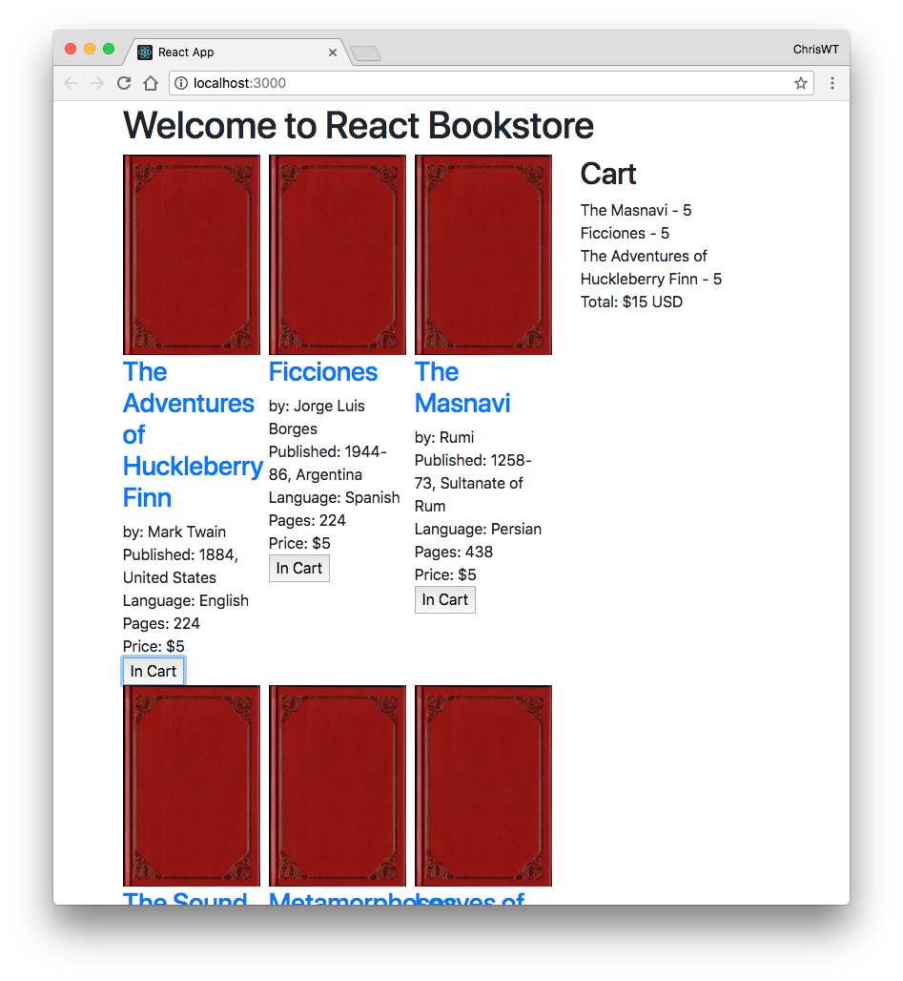
Lab 10: Component Life-Cycle and AJAX

Slide 201
Hooks

Slide 202
The Problem: Functions Aren’t Classes
Functional Components:
can’t have state.
can’t use lifecycle methods.
can’t update state

Slide 203
The Solution
Hooks!

Slide 204
What are Hooks?
Hooks provide access to imperative ways of working in React
Completely opt-in
Backwards compatible
Reduces complexity
Provides a more direct API to props, state, context, refs, and lifecycle
Provides a standard way to reuse behavior between components
Hooks let you use more of React’s features without Classes

Slide 205
But What are Hooks?
Hooks are functions that let you hook into React state and lifecycle features from function components.
Hooks allow you to reuse stateful logic without changing your component hierarchy.

Slide 206
Built-in Hooks
React has several “built-in” hooks.
useState
Takes an initial value and returns a state variable and a method for updating that variable.
useEffect
Adds the ability to perform side effects from a function.
Serves the same purpose as componentDidMount, componentDidUpdate, and componentWillUnmount.
Lets you call a function when any of these lifecycle events happen.

Slide 207
Rules of Hooks
Must be called at the top level
Not inside loops, conditions, or nested functions.
Can only be called from function components.
Hooks start with “use” by convention.

Slide 208
useState
import { useState } from 'react';
function Example() {
const [count, setCount] = useState(0);
return (
<div>
<p>You clicked {count} times</p>
<button onClick={() => setCount(count + 1)}>
Click me
</button>
</div>
);
}
Notes:
In this component, we import react and the useState from the react library. UseState is the hook. When invoked, it returns a pair: the current state value, and a function that lets you update it. UseState only takes one argument: the initial value. The state doesn’t have to be an object, but it can be if you want.

Slide 209
useState can be used multiple times
function ManyStates() {
const [animal, setAnimal] = useState(‘monkey’);
const [name, setName] = useState(‘Chris’);
const [todos, setTodos] = useState([{ text: ‘eat lunch’}]);
// ..
}
Notes:
The names can be anything you want. React assumes that calls to useState will be done in the same order for every render.

Slide 210
useEffect
Adds the ability to perform side effects from a function component.
Serves the same purpose as componentDidMount, componentDidUpdate, and componentWillUnmount
By default, React runs effects after every render, including the first.

Slide 211
useEffect example
function LifecycleDemo() {
useEffect(()=> {
console.log('render!');
//optional "cleanup" return statement to run before render or unmount
return () =>
console.log('unmounting');
})
return “This is a lifecycle demo”;
}

Slide 212
When does useEffect run?
By default: before every render.
Want to run it less often?
Provide a 2nd argument
Array
If one of them has changed, the effect will run again.
Will still run after the initial render.
To run only on Mount and Unmount, pass an empty array ([])
Simulates componentDidMount lifecycle method

Slide 213
Uses for useEffect
Fetch initial data
focus inputs on first render
Re-fetching when data changes

Slide 214
More Built-in Hooks
useContext
useReducer
useCallback
useMemo
useRef
useImperativeHandle
useLayoutEffect
useDebugValue

Slide 215

Lab 11: Converting a Class Component to a Function Component

Slide 216
Context and Refs

Slide 217
Context API
Context allows parents to pass data implicitly to children, no matter how deep the component tree is.

Slide 218

Creating and Using Context for Color Themes
Define a ColorContext to manage color theme state.
Use Context.Provider to wrap components needing theme access.
Utilize useContext hook for easy access to the theme.
Notes:
To create and use a Context for managing color themes, start by defining a ColorContext. This allows you to wrap your components in a Context.Provider, making the theme accessible to all child components. You can then use the useContext hook to quickly access the current theme wherever you need it within your component tree.

Slide 219
Creating a Context
import React, { createContext, useState, useContext } from 'react'; // Create a context with a default value const ColorContext = createContext(); export const ColorProvider = ({ children }) => { const [color, setColor] = useState('light'); // Default theme is 'light' const toggleColor = () => { setColor((prevColor) => (prevColor === 'light' ? 'dark' : 'light')); }; return ( <ColorContext.Provider value={{ color, toggleColor }}> {children} </ColorContext.Provider> ); };
// Custom hook to use the ColorContext export const useColor = () => { return useContext(ColorContext); };

Slide 220
Lab 12:
Creating a Color Theme Context

Slide 221
Refs
Gives React access to a DOM node or an instance of a component.

Slide 222
Creating a ref in a Class Component
class TextReader extends Component {
constructor(props) { super(props); this.textView = React.createRef(); } render() { return ( <textarea ref={this.textView} value={this.props.bookText} /> ); }
}
export default TextReader;

Slide 223
Creating a ref in a Function Component
import {useRef} from 'react';
function TextReader(props) {
const textView = useRef(null);
return (
<textarea ref={textView} value={props.bookText} />
); }
export default TextReader;

Slide 224
Using refs
class TextReader extends Component {
constructor(props) { super(props); this.textView = React.createRef(); }
componentDidMount(){ this.textView.current.focus(); }
render(){
return ( <textarea style={{width:'380px',height:'400px'}} ref={this.textView} value={this.props.bookText} /> ); } } export default TextReader;

Slide 225
When to Use Refs
Managing focus, text selection, or media playback.
Triggering imperative animations.
Integrating with third-party DOM libraries.
Avoid using refs for anything that can be done declaratively.

Slide 226
Custom Hooks
A JavaScript function whose name starts with "use" and that may call other Hooks.
Lets you extract component logic into reusable functions.
Isn't a feature of React, but is enabled by Hooks.

Slide 227
Why Use Custom Hooks
Share logic between components.
Hide complex logic behind a simple interface.

Slide 228
Custom Hooks Examples - useFetch
data fetching Hook
Several different versions currently exist
const { data, loading, setUrl } = useFetch('https://your.api.url/search/');

Slide 229
Making Custom Hooks
Make a function with a name starting with 'use'
Use other hooks inside it
Custom hooks can be reused in multiple components and each instance will have its own isolated state.

Slide 230
Lab 13: Custom Hooks

Slide 231
React with TypeScript

Slide 232
TypeScript Basics
JavaScript with Syntax for Types
Strongly typed language
Converts to JavaScript

Slide 233
Why TypeScript?
Static type checking
Better tooling
Better documentation
More confidence in code
Can be applied gradually

Slide 234
JS vs. TS
JS
TS
function greet(name) {
return `Hello, ${name}!`;
}
greet(17);
"Hello 17!"
function greet(name:string) {
return `Hello, ${name}!`;
}
greet(17);
Argument of type 'number' is not assignable to parameter of type 'string'.

Slide 235
Type inference
When you declare a variable using var, let, or const, you can optionally add a type annotation
let myName: string = "Chris";
However, this isn't necessary most times. TypeScript will infer the type from the type of the initial value.
let myName = "Chris"; // myName is inferred as 'string'

Slide 236
Type annotations in functions
Parameters with type annotations will be checked.
Return values can be annotated too, but it's not usually necessary because TypeScript can infer it.

Slide 237
Annotating Objects
List properties and their types.
function doSomething(options: {speed: number, priority: number, comments?: string})
The ? indicates that a property is optional.
If you don't specify a type, it will be assumed to be 'any',

Slide 238
Union Types
Types formed from two or more types.
function (loginId: number | string) {
...
}
loginID can be either a number or a string

Slide 239
Type aliases
A name for a type
Allows reuse of types
type Coords = {
x: number,
y: number
}

Slide 240
Interfaces
Another way to name a type.
interface Coords {
x: number,
y: number
}
Interfaces can be extended, unlike aliases.

Slide 241
Extending Interfaces
Interface Person {
name: string
}
Interface Customer extends Person {
creditLimit: number
}

Slide 242
Type Assertions
Specifies a more specific type than TS can know about.
const myCanvas = document.getElementById("main_canvas") as HTMLCanvasElement;

Slide 243
Literal Types
Sets a type to a specific value.
let x: "hello" = "hello";
Is useful when used with unions to specify possible values for a variable.
function printText(s: string, alignment: "left" | "right" | "center") {

Slide 244
Generics
Allow type specification to be deferred.
function arrayFilled<T>(item1: T, item2: T): T[] {
let list = new Array<T>();
list.push(item1);
list.push(item2);
return list;
}
let myArray = arrayFilled<number>(1,2);

Slide 245
React TypeScript Cheatsheet
https://github.com/typescript-cheatsheets/react#reacttypescript-cheatsheets
Really handy copy / paste examples

Slide 246
File Naming
For files containing JSX:
filename.tsx
For other TS files:
filename.ts

Slide 247

Lab 14: Converting to TypeScript

Slide 248
React Patterns and Best Practices

Slide 249
F.I.R.S.T.
React Components should be:
Focused
Independent
Reusable
Small
Testable

Slide 250
Single Responsibility
A component should only do one thing.
If it ends up growing, it should be decomposed into smaller subcomponents.
A responsibility is a "reason to change."
Single responsibility makes components more robust.
"A class should have only one reason to change."
-Robert C. Martin

Slide 251
Pure Functions
Pure functions always return the same result given the same arguments.
Pure function's execution doesn't depend on the state of the application.
Pure functions don't modify the variables outside of their scope (no side effects).

Slide 252
Benefits of Pure Functions
Easy to test
Easy to reason about
Easy to reuse
Easy to reproduce the results
Notes:
Pure functions make thinking about your program easier because you don't have to know the current state when the function is called. You know that each time the function is called with the same arguments, you'll get the same result.
This also makes pure functions easy to test because you don't need to mock and assert the state of your app before each test. You just give them input and assert the output.
They're also easy to reuse

Slide 253
Function Comparison
slice()
splice()
let toppings = ['cheese','pepperoni','mushrooms'];
toppings.slice(0,2);
// ["cheese", "pepperoni"]
toppings.slice(0,2);
// ["cheese", "pepperoni"]
toppings.slice(0,2);
// ["cheese", "pepperoni"]
Always returns the same result given the same arguments
Doesn't depend on the state of the application
Doesn't modify variables outside its scope
It's a Pure Function!
let toppings = ['cheese','pepperoni','mushrooms'];
toppings.splice(0,2);
// ["cheese", "pepperoni"]
toppings.splice(0,2);
// ["mushrooms"]
toppings.splice(0,2);
// []
Not Pure!
Notes:
With a non-pure function, the state matters in what result is produced.

Slide 254
React.PureComponent
If your Component returns the same result given the same props and state, use React.PureComponent
PureComponent does a shallow state and prop comparison and doesn't update if the component is unchanged.
May give a performance boost
class MyComponent extends React.PureComponent {
...
}

Slide 255
React.memo
Works the same as React.PureComponent, but for functional components.
const MyComponent = React.memo(
function MyComponent(props) {
...
});

Slide 256
Composition
Composition is combining smaller components to form a larger whole.

Slide 257
Container (aka Page) Components
Wrap presentational components
Contain the logic and state
Correspond to pages
Examples:
HomePage
ServicesPage

Slide 258
Presentational Components
Components that just output presentation
Contain no logic
Responsible for generating UI elements
Display data passed by Pages

Slide 259
Folder Structure
Organize projects by Feature
Keep Pages and Presentational components separate
- /pages
- /pages/App.jsx
- /pages/ShoppingCart.jsx
- /components
- /components/Header.jsx
- /components/ProductInfo.jsx
/services
/services/api.js
/context
/index.jsx

Slide 260
Higher Order Functions
A function that can take another function as an argument and/or that returns a function as a result.
const multiplyBy = function(multiplier){
return (number) => number * multiplier
}
const double = multiplyBy(2); // returns (number) => number * 2
double(10) // returns 20

Slide 261
Higher Order Components
A function that takes (wraps) a component and returns a new component.
Allow us to abstract over actions, not just values.
const EnhancedComponent = higherOrderComponent(WrappedComponent);

Slide 262
Reusable Components
Break down the common design elements (buttons, form fields, layout components, etc.) into reusable components with well-defined interfaces.
The next time you need to build some UI, you can write much less code.
This means faster development time, fewer bugs, and fewer bytes down the wire.

Slide 263
Testing React
Objectives
Learn the TDD Steps
Write Assertions
Understand exception handling in JS
Create tests with Jest
Automate cross-browser testing

Slide 264
Goal of TDD
Clean code that works.

Slide 265
The TDD Cycle
Red
write a little test that doesn't work.
Green
make the test work, as quickly as possible.
don't worry about doing it right.
Refactor
eliminate duplication created in making the test work.

Slide 266
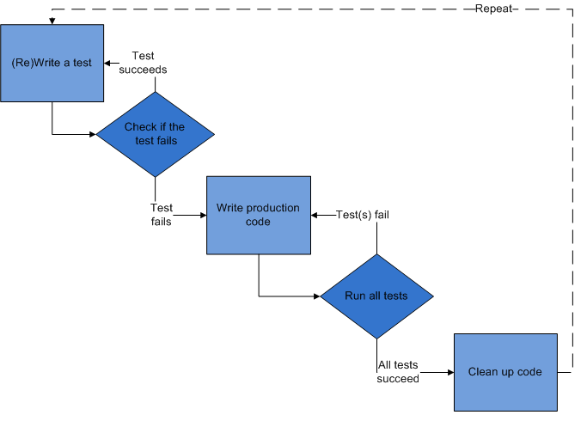
TDD Steps
Write a test
Check that test fails
Write code
Run test - passes!
Refactor
Repeat

Slide 267
Red
Write the story.
Invent the interface you wish you had.
Characteristics of a good tests:
Each test should be independent of the others.
Any behavior should be specified in only one test.
No unnecessary assertions
Test only one code unit at a time
Avoid unnecessary preconditions

Slide 268
Green
Get the test to pass as quickly as possible.
Three strategies:
Fake it
Do something, no matter how bad, to get the test to pass.
Use an obvious clean solution.
But don't try too hard!
Triangulation
only generalize code when you have two examples or more.
When the 2nd example demands a more general solution, then and only then do you generalize.

Slide 269
Refactor
Make it right.
Remove duplication.
Improve the test.
Repeat.
Add ideas or things that aren't immediately needed to a todo list.

Slide 270
Assertions
Expression that encapsulates testable logic
Assertion Libraries
Chai, should.js, expect.js, better.assert
Examples
expect(buttonText).toEqual('Go!'); // jasmine
result.body.should.be.a('array'); // chai
equal($("h1").text(), "hello"); //QUnit
assert.deepEqual(obj1, obj2); //Assert

Slide 271
JavaScript Testing Frameworks
Jasmine
Mocha
doesn't include its own assertion library
QUnit
from JQuery
js-test-driver
YUI Test
Sinon.JS
Jest
Vitest

Slide 272
JS Exception Handling
function hello(name) {
return "Hello, " + name;
}
let result = hello("World");
let expected = "Hello, World!";
try {
if (result !== expected) throw new Error
("Expected " + expected + " but got " +
result);
} catch (err) {
console.log(err);
}
Notes:
By using JavaScript's built-in try throw catch, you can write assertions and throw errors if the test of the assertion doesn't pass. If it doesn't, you can fix the code until the test passes. This test will fail. (node ./src/trythrowcatch.js). You could write an assertion function to simplify this, or you can use an assertion library that already exists.

Slide 273
Vitest Overview
Objectives
Write test suites
Create specs
Set expectations
Use matchers
Notes:
Jasmine is a Behavior-driven Development framework that includes its own assertion library.

Slide 274
How Vitest Works
Suites describe your tests
Specs contain assertions
describe("This is a suite", function() {
let a;
test("A spec test assertions", function() {
a = true;
expect(a).toBe(true);
});
});

Slide 275
Test Suites
Created using the describe function
Contain one or more specs
2 params
Text description
Function
describe("Hello", function() {
...
}

Slide 276
Specs
Created using the it or test function
they're the same thing
Contains one or more expectations
expectations === assertions
describe("Hello", function() {
it("Concats Hello and a name", function() {
let expected = "Hello, World!";
let actual = hello("World");
expect(actual).toEqual(expected);
});
});

Slide 277
Expectations
AKA assertions
Made using expect function,
Takes a value
Chained to a Matcher
Takes the expected value
expect(actual).toEqual(expected);

Slide 278
Matchers
expect(fn).toThrow(e);
expect(instance).toBe(instance);
expect(mixed).toBeDefined();
expect(mixed).toBeFalsy();
expect(number).toBeGreaterThan(number);
expect(number).toBeLessThan(number);
expect(mixed).toBeNull();
expect(mixed).toBeTruthy();
expect(mixed).toBeUndefined();
expect(array).toContain(member);
expect(string).toContain(substring);
expect(mixed).toEqual(mixed);
expect(mixed).toMatch(pattern);

Slide 279
Testing React Components
Objectives
Learn about different rendering modes
Learn about Jest
Write Unit Tests with Jest

Slide 280
What to Test in a React Component
Does it render?
Does it render correctly?
Test every possible state / condition
Test the events
Test the edge cases

Slide 281
Vitest
Runs any tests in __tests__ directories, or named .spec.js, or named .test.js
Simulates browser environment with jsdom

Slide 282
Mocking
Mock Function - erase the implementation of a function – vi.fn()
Manual Mocking - stub out functionality with mock data
Timer Mocking - swap out native timer functions

Slide 283
Mock Function
const mockCallback = vi.fn();
forEach([0, 1], mockCallback);
// The mock function is called twice
expect(mockCallback.mock.calls.length).toBe(2);
// The first argument of the first call to the function was 0
expect(mockCallback.mock.calls[0][0]).toBe(0);
// The first argument of the second call to the function was 1
expect(mockCallback.mock.calls[1][0]).toBe(1);

Slide 284
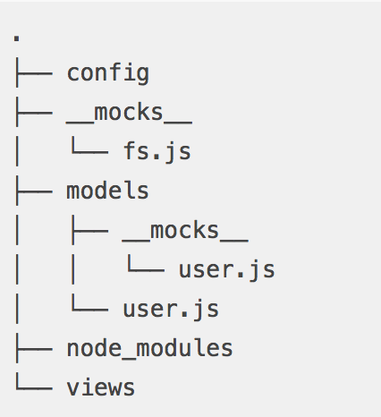
Manual Mock
Ensures tests will be fast and reliable by mocking external data and core modules.
Define in a __mocks__ subdirectory adjacent to the module

Slide 285
Snapshot Testing
Renders a component
Creates a "snapshot file" on first run
Compares subsequent runs with first and fails test if different.

Slide 286
Sample Snapshot Test
import React from 'react';
import App from './App';
it('renders as expected', () => {
const { container } = render(<App />);
expect(container).toMatchSnapshot();
});

Slide 287
React-Testing-Library
const container = render(<App />);

Slide 288
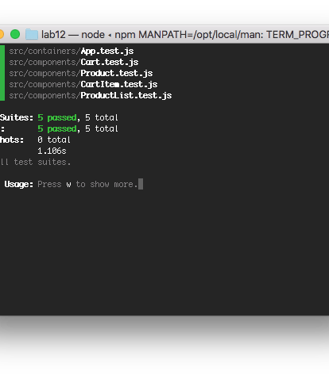
Lab 15: Writing Tests with Vitest and RTL

Slide 289
Flux and Redux
Objectives
Understand the Flux pattern
Explain Redux's architecture
Create Redux actions
Write pure functions
Use Reducers
Use Redux with AJAX

Slide 290
Flux
Flux isn't a library or module.
It's a design pattern.
npm install flux installs Facebook's dispatcher.
It's possible to use Flux design principles without Facebook's module.

Slide 291
Flux Flow
Some sort of interaction happens in the view.
This creates an action, which the dispatcher dispatches.
Stores react to the dispatched action if they're interested, updating their internal state.
Stateful view component(s) hear the change event of stores they're listening to.
Stateful view component(s) ask the stores for new data, calling setState with the new data.

Slide 292
Flux Action
An action in flux is what's made when something happens.
In other words, when you click on something, that's not an action
it creates an action. Your click is an interaction.
Actions should have (but aren't required to have) a type and a payload. Most of the time they will have both, occasionally they'll just have a type.

Slide 293
Flux Dispatcher
Broadcasts actions when they happen and it lets things tune in to those broadcasts
Instead of an onClick function using a callback passed to it to set the state of your application, you have it (onClick) use the dispatcher to dispatch a specific action for anyone who's interested to listen for.

Slide 294
Flux Stores
Represents the ideal state of your application
If a user enters something into a form, it dispatches an action. If the store is listening for this action, it will update its internal state accordingly.
Stores don't contain any public setters, just public getters. The only ones who can change the data in a store is the store itself when it hears an action from the dispatcher that it's interested in.

Slide 295
EventEmitter
Stores emit change events that don't contain data.
If the view is listening for the particular store's change event, the view should ask the store for the new data that will bring the view back into sync, call setState, and re-render.

Slide 296
Redux
An implementation of Flux
Stores state of the app in an object tree in a single store
The state tree can only be changed by emitting an action
Specify how the actions transform the state tree using pure reducers

Slide 297
Stores & Immutable State Tree
The biggest difference between Flux and Redux is that Redux has a single store.
Redux has a single store with a single root reducing function.
Split the root reducer into smaller reducers to grow the app.
Trace mutations by replaying actions that cause them.

Slide 298
Redux Actions
Payloads of information that send data from the application to the store.
Actions are the only way to mutate the internal state.
Use store.dispatch() to send them to the store.
{
type: 'ADD_TODO',
text: 'Build my first Redux app'
}

Slide 299
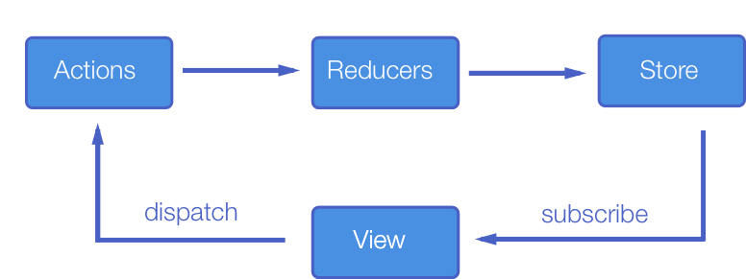

Slide 300
Reducers
Specifies how the application's state changes in response to something happening (an action).
A pure function that takes the previous state and an action, and returns the next state.
(previousState, action) => newState

Slide 301
Things You Should Never do in a Reducer
Mutate its arguments
Perform side effects like API calls and routing transitions
Call non-pure functions

Slide 302
Reducer Composition
The fundamental pattern of building Redux apps
Split up reducer functions using child reducers.
Workflow
Write top-level reducer to handle a particular function.
Break up the top-level reducer into a master reducer that calls smaller reducers to separate concerns.

Slide 303
Higher Order Reducer
combineReducers() is a higher order reducer
A higher order reducer is a higher order function that returns a new reducer.

Slide 304
Redux Store
Holds the application state
Allows access to state via getState()
Allows state to be updated via dispatch(action)
Registers listeners via subscribe(listener)
Handles unregistering of listeners via the function returned by subscribe(listener)

Slide 305
Redux Store Design
Many applications use data that is relational or "nested"
let orders = [
{
id:1,
customer:{id:20,name:"Wilma",address:""},
items:[{id:10,name:"Toaster",price:20}
}
]
Relational data mapped to objects can be complex and cause repetition.

Slide 306
Redux Store Design
Solution: Normalize part of your store, and treat it like a database.
Data normalization:
Each type of data gets its own "table" in the state.
Each "data table" should store the individual items in an object, with the IDs of the items as keys and the items themselves as the values.
Any references to individual items should be done by storing the item's ID.
Arrays of IDs should be used to indicate ordering.

Slide 307
Normalized Redux Store Example
{
orders : {
byId : {
"order1" : {id : "order1", customer : "customer1",
items: ["item1","item2"]},
"order2" : {id : "order2", customer : "customer1",
items: ["item1","item6"]}
},
allIds : ["order1", "order2"] },
customers : {
byId : {
"customer1" : { ... }
...
}

Slide 308
Benefits of Normalizing Store
Each item is defined in only one place
Simplifies Reducer logic (flatter structure)
Simplifies logic for retrieving and updating items
Because each data type is separated, updates to a single type of data require fewer components to be re-rendered

Slide 309
Redux Pros and Cons
Redux Pros
Redux Cons
Declarative
Immutable state
Mutation logic separate from views
Great for testing
More complicated than just using plain react components

Slide 310
Redux Toolkit
Utilities for simplifying common Redux use cases.

Slide 311
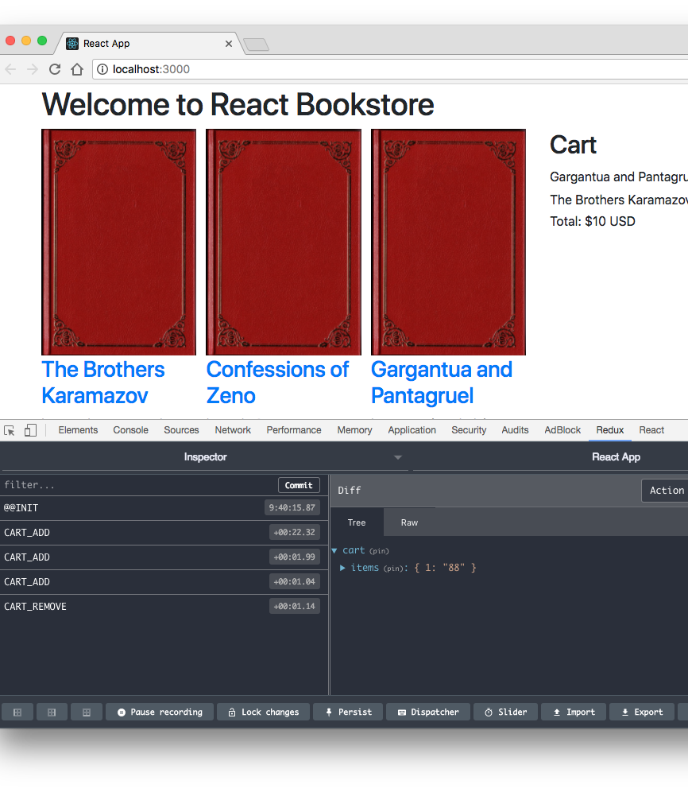
Lab 16: Implementing Redux

Slide 312
What is Redux Middleware?
a higher-order function that composes a dispatch function to return a new dispatch function.
a third-party extension point between dispatching an action and the reducer.
Action
Reducer
Middleware

Slide 313
What is Middleware Good For?
Logging actions
Reporting errors
Dispatching new actions
Asynchronous requests

Slide 314
Redux Thunk
Allows you to write action creators that return a function instead of an object.

Slide 315
How is Thunk Useful?
delay the dispatch of an action
dispatch only if a certain condition is met
perform async network operation
database
AJAX

Slide 316
How does Thunk work?
Redux Thunk middleware is added to the store
When an action creator returns a function, that inner function will get executed by the Thunk middleware.
The inner function receives the store methods dispatch and getState() as parameters.
On success, the Thunk action calls a standard action.

Slide 317
Redux Saga
Useful for complex async operations.
Uses generator functions to complete actions in series.
redux-saga.js.org/docs/introduction/BeginnerTutorial.html

Slide 318
Using Sagas
//install redux-saga
npm install --save redux-saga
//dispatch an action
class UserComponent extends React.Component {
...
onSomeButtonClicked() {
const { userId, dispatch } = this.props;
dispatch({
type: 'USER_FETCH_REQUESTED',
payload: {userId}});
}
... }

Slide 319
Using Sagas (cont.)
// create a "worker" saga to do the async action
import { call, put, takeEvery, takeLatest } from 'redux-saga/effects';
import Api from '...';
// worker Saga: will be fired on USER_FETCH_REQUESTED actions
function* fetchUser(action) {
try {
const user = yield call(Api.fetchUser, action.payload.userId);
yield put({type: "USER_FETCH_SUCCEEDED", user: user});
} catch (e) {
yield put({type: "USER_FETCH_FAILED", message: e.message});
}
}

Slide 320
Using Saga (cont.)
// create a listener saga to listen for the event
function* mySaga() {
yield takeEvery("USER_FETCH_REQUESTED", fetchUser);
}
/* Alternatively you may use takeLatest.
function* mySaga() {
yield takeLatest("USER_FETCH_REQUESTED", fetchUser);
}
*/
// export mySaga
export default mySaga;
Notes:
The first function starts fetchUser on each dispatched `USER_FETCH_REQUESTED` action. Allows concurrent fetches of user.
The second way does not allow concurrent fetches of user. If "USER_FETCH_REQUESTED" gets dispatched while a fetch is already pending, that pending fetch is cancelled and only the latest one will be run.

Slide 321
Using Saga (cont.)
// Connect Saga to the store, using middleware
import { createStore, applyMiddleware } from 'redux';
import createSagaMiddleware from 'redux-saga';
import reducer from './reducers';
import mySaga from './sagas';
// create the saga middleware
const sagaMiddleware = createSagaMiddleware();
// mount it on the Store
const store = createStore( reducer, applyMiddleware(sagaMiddleware) );
// then run the saga
sagaMiddleware.run(mySaga);
// render the application

Slide 322
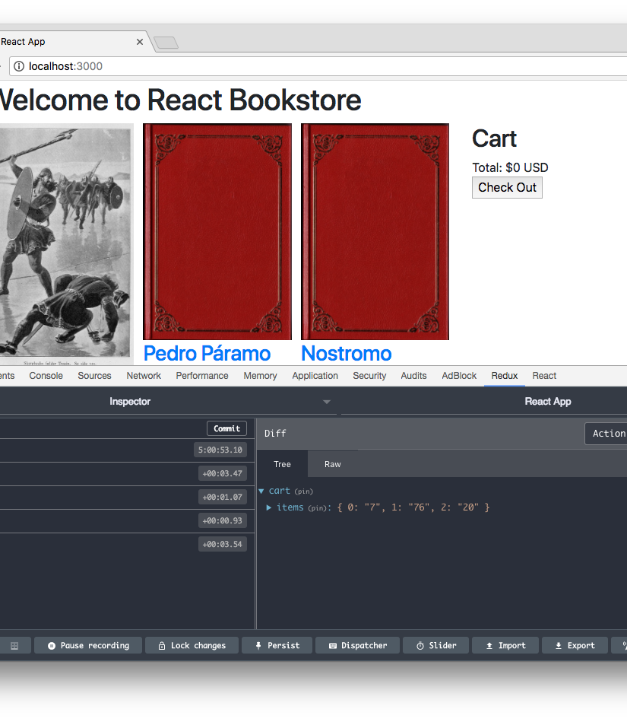
Lab 17: Redux Thunk

Slide 323

Lab 18: Persisting Data in localStorage with Redux

Slide 324
Routing

Slide 325
React Router
Declarative way to do routing
Maps elements to URLs
Dynamic routing
Routing takes place as the component is rendering
Not in a configuration
Almost everything in React Router is a component

Slide 326
Using React Router
Import the version of React Router for your target environment (i.e. DOM or Native), plus other components
import { BrowserRouter, Routes, Route, Link } from 'react-router-dom'
Render the Router
root.render((
<BrowserRouter> <App/> </BrowserRouter>)
Use <Link> to link to a new location (in <App> in this case)
<Link to="/dashboard">Dashboard</Link>
Render Routes.
<Routes>
<Route path="/dashboard" element={<Dashboard />}/>
</Routes>

Slide 327
Router Rendering Example
import { BrowserRouter } from 'react-router-dom’;
root.render((
<BrowserRouter>
<App/>
</BrowserRouter>
))
Use BrowserRouter when you have a server
Use HashRouter if you're using a static file server.

Slide 328
Route Matching
Route
Compares the value of the path prop to the current location's pathname.
Renders the element specified by the element prop.
Can be used anywhere you want to render based on location.
Switch (v5), Routes (v6)
Can be (optionally) used for grouping Routes. Will iterate through a group and stop when a match is found.

Slide 329
The match Object
The Route component passes an object named match to components.
The match object contains information about the match.
One imported property of match is match.params
Params are passed in the URL
<Link to="/users/4">View User Details</Link>
<Route path="/users/:uid" element="<User />" />
You can access them using React Router's useParams hook.

Slide 330
Navigation
<Link>
Creates links in your application.
Inserts an <a> in your HTML
<NavLink>
Can be styled as "active" when it matches the current location.

Slide 331

Lab 19: React Router

Slide 332
Deploying React

Slide 333
Development vs. Production
Development build
Uncompressed.
Displays additional warnings that are helpful for debugging.
Contains helpers not necessary in production
~669kb
Production build
Compressed.
Contains additional performance optimizations.
~147kb

Slide 334
Perf Object
Indicates expensive parts of your app.
Only available in development mode.
Notes:
The Perf object is available in development mode by requiring 'react-addons-perf'. To use it, start measuring with Perf.start(), stop it with Perf.stop() and then use the other methods to find out the results.

Slide 335
Perf Object Methods
Methods
start() and stop()
Start and stop measurement
Records operations in-between
printInclusive(measurements)
Prints the overall time taken
Defaults to the measurements from the last recording
Outputs a nice-looking table
printExclusive(measurements)
Doesn't include time taken to mount components, process props, etc.
printWasted(measurements)
"Wasted" time is spent on components that didn't render anything
printOperations(measurements)
Prints the underlying DOM manipulations

Slide 336
Optimization Techniques
Use shouldComponentUpdate hook to add optimization hints to React's diff algorithm
shouldComponentUpdate: function() {
// Let's just never update this component again.
return false;
},
Use keys
Unique identifier created with key attribute.

Slide 337
Code Splitting
Improves the performance of your app by lazy loading only the components that are currently needed.
Two ways
dynamic import
import ("./math").then(math => {
console.log(math.add(43,32));
})
React.lazy
const MyComponent =
React.lazy(()=>import ('./Header'));

Slide 338
Using Lazy Loaded Component
import React, { Suspense } from 'react';
const OtherComponent = React.lazy(() =>
import('./OtherComponent'));
function MyComponent() {
return (
<div>
<Suspense fallback={<div>Loading...</div>}>
<OtherComponent />
</Suspense>
</div>
);
}

Slide 339
Building Your Project
In create-react-app, run the build script
npm run build
Build makes a build directory, which contains:
index.html
static assets (js and css)
sourcemap files
asset-manifest.json

Slide 340
Deploying React
React apps can be served using plain old HTTP servers, node servers, or cloud hosting.
Popular hosting options include:
Netlify
Firebase
Heroku
AWS
To deploy/host for free, you can use Github Pages

Slide 341
Server-side React
Allows you to pre-render components' initial state on the server
Methods:
renderToString
Returns an HTML string
Send the markup down on the initial request for faster page loads and to allow search engines to crawl your pages for SEO purposes.
renderToStaticMarkup
Works the same as renderToString, but doesn't add in the extra React DOM elements
Good for using React as a static page generator

Slide 342
Render Caching
A technique for making web pages load faster on subsequent visits.
Encapsulate load state so that no server call is required to render the initial view
Make all API calls before render()
Cache locally in the unload handler
Restore the last known state on load
Render the last known state in react using ReactDOM.hydrate
Notes:
https://css-tricks.com/render-caching-for-react/

Slide 343
ReactDOM.hydrate
import {render, hydrate} from "react-dom"
if (window.hasRestoredState) {
hydrate(<MyPage />, renderTarget);
} else {
render(<MyPage />, renderTarget);
}

Slide 344
Lab 20: Deploy to Github Pages
Follow the instructions here:
https://dev.to/yuribenjamin/how-to-deploy-react-app-in-github-pages-2a1f

Slide 345
Advanced Topics

Slide 346
GraphQL

Slide 347
What is GraphQL
a query language for APIs
a runtime for fulfilling queries

Slide 348
How does GraphQL Work?
Query using JSON-like syntax
Data returned matches shape of query

Slide 349
Example Query and Response
{
customer {
firstname
lastname
address
city
state
zip
}
}
{
”customer”: {
”firstname”: “June”,
“lastname”:”Sommerville”,
“address”:”861 Oak St”,
“city”:”Sacramento”,
“state”:”California”,
“zip”:”95814”
}
}

Slide 350
GraphQL is a pattern
Can be implemented using any language
Tools are available for working with JavaScript, Go, PHP, Java, C#, Python, Swift, Rust, Ruby, and more.

Slide 351
GraphQL and JavaScript
Client
Apollo Client
AWS Amplify
Relay
Server
Apollo Server
Express GraphQL

Slide 352
Lab 1: Getting Started with Apollo Server

Slide 353
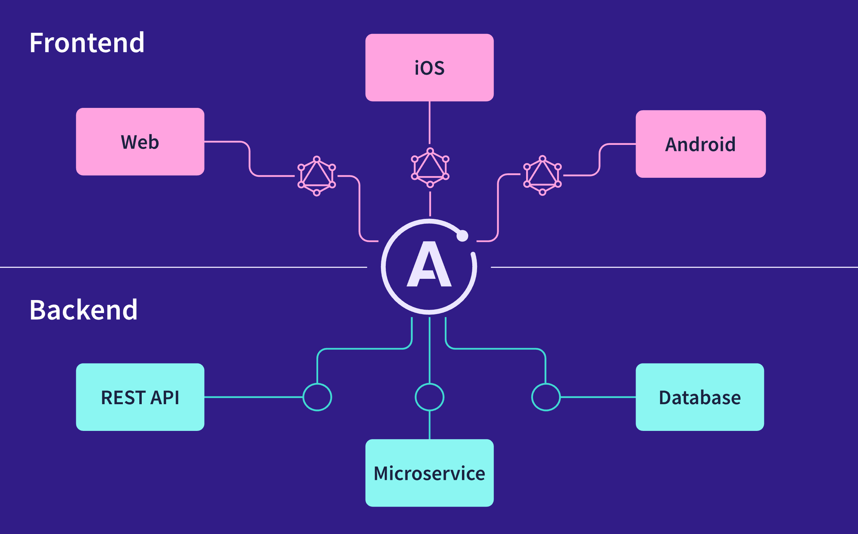
What is Apollo Server?
open source GraphQL server

Slide 354
Apollo Studio Explorer
a free web-based IDE for GraphQL
a tool for building GraphQL servers using a schema

Slide 355
GraphQL Schema
defines object types that can be fetched
created using GraphQL Schema Language

Slide 356
Components of a GraphQL schema
Object Types
Query Types
Mutation Types
Subscription Types

Slide 357
Anatomy of a Type
Types are written similarly to how TypeScript Types are written
Object types start with type followed by the Name of the object
type Customer {
The body is key: type pairs
firstName: String
lastName: String
email: String
orders: [Order]

Slide 358
Basic Data types
Available data types are:
Scalar types
String
Int
Float
Boolean
ID (a unique ID not meant for human reading)
List types
Surround a type with []

Slide 359
Not null
Add ! after a type to indicate that it's required
type Customer {
id: ID!
firstName: String!
lastName: String!
orders: [Order}
}

Slide 360
Query and Mutation Types
Define entry points to the schema
type Query {
customers: [Customer]
orders: [Orders]
}

Slide 361
Passing Arguments
Pass arguments using parentheses after the name.
type Query {
customer(id:ID!):Customer
order(id:ID!):Order
}
type Mutation {
addCustomer (firstName:String!,lastName:String!,email:String): Customer
}

Slide 362
Lab 2: Using Apollo Studio

Slide 363
Apollo Client
A state management library for JavaScript
Manages both local and remote data with GraphQL
To create a client instance:
const client = new ApolloClient({
uri: 'http://localhost:4000’,
cache: new InMemoryCache(),
});

Slide 364
Apollo Dev Tools
A Chrome and Firefox extension for Apollo Client
To enable (after installation):
const client = new ApolloClient({
uri: 'http://localhost:4000',
cache: new InMemoryCache(),
connectToDevTools: true,
});

Slide 365
Lab 3: Creating a client

Slide 366
Connecting to Data
Create a datasource
Define resolvers

Slide 367
Lab 4: Connecting to a data source

Slide 368
Lab 5: Creating Resolvers

Slide 369
Lab 6: Setting up the server for Mutations

Slide 370
Lab 7: Making mutations from a client

Slide 371
What is Relay?
Framework for building data-driven react applications
Simpler than Flux, but may also be used with Flux
Use GraphQL as a query language.

Slide 372
GraphQL
Data query language and runtime
Declarative
Compositional
Strongly Typed

Slide 373
GraphQL Example
Query
Response
{ user(id: 3500401) { id, name, isViewerFriend, profilePicture(size: 50) { uri, width, height } } }
{ "user" : { "id": 3500401, "name": "Jing Chen", "isViewerFriend": true, "profilePicture": { "uri": "http://someurl.cdn/pic.jpg", "width": 50, "height": 50 } } }

Slide 374
GraphQL Pros and Cons
Pros
Cons
Requires GraphQL server
More complexity
Less flexible
Even more declarative
No custom getter logic
Tight server integration

Slide 375
Micro Frontends
Micro Frontends decompose frontend applications into independent units in the same way that microservices decompose the back end.
Gives teams the ability to independently develop, test, and deploy each micro frontend.

Slide 376
React Micro Frontends
Challenges:
Overhead: Each micro frontend needs to access the same libraries, CSS, routes
Can create massive problem of duplication of code and poor performance
Cross-cutting concerns: Each frontend needs to share authentication, for example.
Communication between micro frontends is more complex than between components in an app.

Slide 377
Common strategies for React Micro frontends
Use a container application to handle rendering and routing between the micro frontends.
Use a CDN to host shared frontend libraries and resources.
Make use of React Portals to render components from an application outside of its root DOM node.

Slide 378
Shared State in React Micro Frontends
Four strategies
Web workers
Props and callbacks
Custom events
Pub Sub library

Slide 379
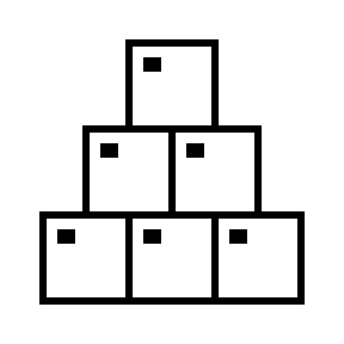
Lab 19: Creating Micro Frontends

Slide 380
Bonus Lab:
Implement Shared State
Working in teams, figure out how to move the Cart out of the Bookstore Micro frontend and into its own.
Implement the necessary shared state to make the application work correctly.

Slide 381
JavaScript Development Ecosystem and Tools
Objectives:
Configure your IDE
Use Node.js as a development tool
Use NPM to install and manage packages
Use Git for version control
Use command line dev tools
Notes:
Front end developers work primarily with JavaScript, CSS, and HTML. In recent years, the emphasis has shifted away from HTML and CSS, and today React makes it possible for someone who only has a basic understanding of HTML and CSS to build complex appliations -- as long as they have the JavaScript skills, of course.

Slide 382
Code Editors and IDEs
MS Visual Studio Code
JetBrains WebStorm
Atom (atom.io)
Adobe Brackets
Eclipse
Emacs
IntelliJ IDEA
Netbeans
Sublime Text
vi/Vim
Notes:
Today, there are plenty of code editors and IDEs available for JavaScript development. Purists still maintain that vi or eMacs are all you need, but with so many different libraries and tools involved in modern front-end development, professional developers should take advantage of the advanced features of a full IDE. The most popular and one of the best is currently Visual Studio Code, and that's what we'll be using in this course. We don’t endorse any particular code editor, however, and we encourage developers to experiment with as many IDEs as they can.

Slide 383
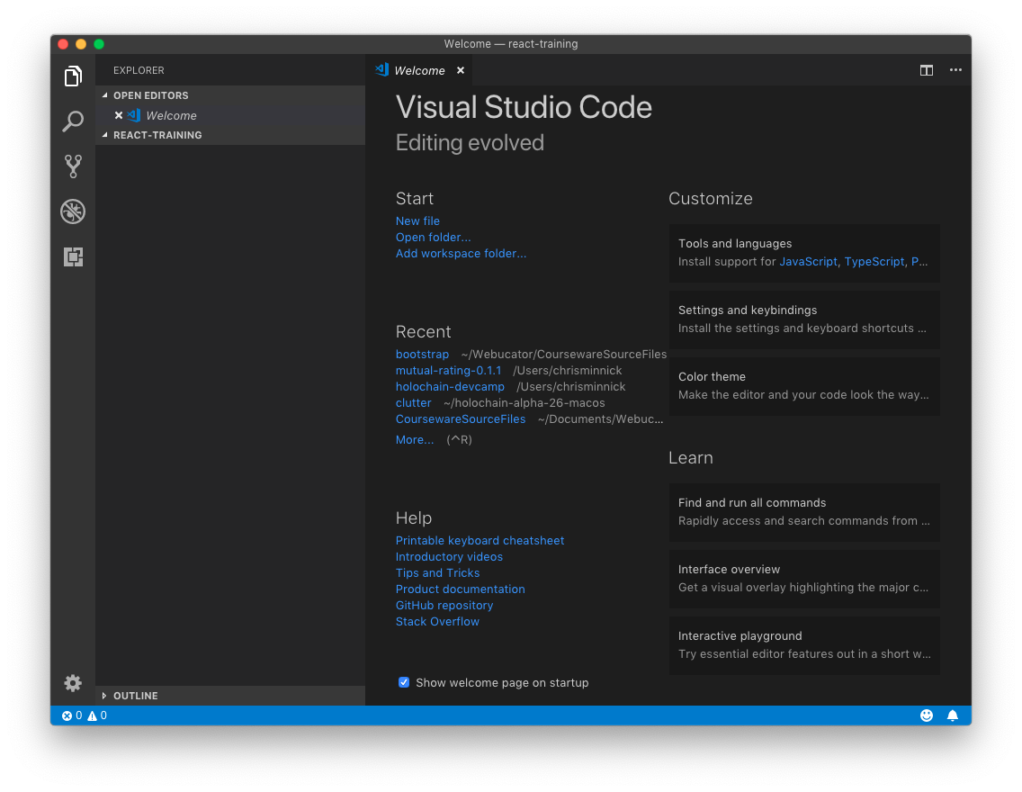
Lab: Visual Studio Code

Slide 384
Node.js
Objectives
Install Node
Test node and get started using npm

Slide 385
What is Node.js?
JavaScript runtime
Built on Google Chrome's V8 JavaScript engine
Open-source
Event-driven
Non-blocking
Never waits
Single-threaded
Can handle thousands of concurrent connections with minimal overhead
No buffering
Used on the server as well as for development automation
Notes:
Node started its life as a way to run javascript on the server. However, it's become an essential tool for managing modules, running tools, and automating front-end development.
Node.js allows you to run JavaScript from the command line.

Slide 386
How is Node.js Different?
JavaScript is single-threaded
A Node application has one event loop, and gives you the benefit of multithreading with async operations
Can handle thousands of concurrent connections with minimal overhead
No buffering
Node applications never buffer data.
Data is output in chunks.
Non-blocking
Node doesn't wait for data to be returned from APIs.
While it's possible to write blocking code in Node.js, it's discouraged.

Slide 387
A Simple Node.js Example
const http = require('http');
const hostname = '127.0.0.1';
const port = 3000;
const server = http.createServer((req, res) => {
res.statusCode = 200;
res.setHeader('Content-Type', 'text/plain');
res.end('Hello World\n');
});
server.listen(port, hostname, () => {
console.log(`Server running at http://${hostname}:${port}/`);
});

Slide 388
EventEmitter
Node is event driven.
EventEmitter is a class that lets you listen for events and assign actions when those events occur.
Very loose way of coupling different parts of your application together.
let EventEmitter = require("events").EventEmitter;
let ee = new EventEmitter();
ee.on("someEvent", function () {
console.log("event has occured");
});
ee.emit("someEvent");

Slide 389
Modules Overview
Node uses CommonJS for loading modules
Original name was ServerJS
Provides a way to import dependencies in JavaScript when used outside the browser (such as server side or in desktop applications)
module.exports
Encapsulates code into a module
require
Imports a module into JavaScript code

Slide 390
CommonJS Example
foo.js
var circle = require('./circle.js');
console.log('Area of circle: ' + circle.area(4));
circle.js
exports.area = function(r){
return Math.PI * r * r;
}

Slide 391
Front-end Node
Node has become an essential part of front end development.
It's used by:
Package installers
Task runners
Testing frameworks
CSS compilers
JS Transpilers
Web servers
Web browsers (PhantomJS)
and more!

Slide 392
Git
Objectives
Learn about how Git works
Learn a typical Git workflow
Install Git
Use the most common Git commands

Slide 393
What is Version Control?
Essential component of any development workflow
Records changes to files over time
Allows recalling of specific versions
Makes collaboration possible
Makes software development safer

Slide 394
History of Git
From 2002 - 2005, the Linux Kernel used the proprietary BitKeeper VCS.
In 2005, after a falling out with BitKeeper's developer, they decided to create their own VCS.
Goals
Speed
Simple design
Strong support for non-linear development
Fully distributed
Able to handle large projects

Slide 395
What is Git?
Version Control System (VCS)
Different from SVN, CVS, etc
Other VCS: store list of changes
Git: store a snapshot of files at time of commit
Doesn't restore unchanged files
Nearly every operation is local
Generally only adds data
It's difficult to do something that can't be un-done.
Notes:
Git thinks about its data as a stream of snapshots. When you commit, git stores a snapshot of what the files look like. If something hasn't changed, git doesn't store the file again, just a reference to the previous identical file it has already stored.
Most operations in Git only need local files and resources to operate. You have the entire history of the project on your local disk, which makes operations much faster.
Also, there's very little you can't do if you're offline.

Slide 396
3 States of Git
Git has three states that your files can reside in:
Modified
Data changed but not committed
Staged
File is marked to go into your next snapshot
Committed
Data stored in your local repo
Notes:
The Git directory (repository) is where Git stores the metadata and object database for your project. This is the most important part of Git, and it is what is copied when you clone a repository from another computer.
The working directory is a single checkout of one version of the project. These files are pulled out of the compressed database in the Git directory and placed on disk for you to use or modify.
The staging area is a file, generally contained in your Git directory, that stores information about what will go into your next commit. It’s sometimes referred to as the “index”, but it’s also common to refer to it as the staging area.

Slide 397
Git Workflow
Modify files
Stage the files
Adds snapshots to the staging area
Git add
Git add is dual-purpose: it tells git to track new files and it stages changes to existing files.
Commit
Stores a snapshot permanently in your Git directory
Git commit
You can also skip the staging area by using the -a option with git commit. This will automatically stage all tracked files before doing the commit.

Slide 398
Lab - Version Control With Git

Slide 399
Command Prompt
Objectives
Use a Unix-style command prompt
Get familiar with basic commands
Notes:
The command prompt is absolutely required for front-end development, so it's important that you get comfortable with it.

Slide 400
Know Your Shell
Bash shell
Terminal (Mac)
Git bash (Windows)
You can use the windows command prompt, but it has its own non-standard commands, so using a bash emulator is recommended.
cd = change directory
./ = current directory
../ = up one directory
ls = list files
ls -la = long list format and don't hide files starting with .
pwd = print working directory
mkdir = create a new directory
cp [source] [dest] = copy
mv [source] [dest] = move, or rename
rm = remove files or directories
help = get bash commands
-help = get help with a command
Notes:
The command prompt for MacOS is called Terminal. It's located inside Applications > Utilities
On Windows, use git bash so that the Unix commands in this course will work correctly.

Slide 401
Chapter 2: Reproducible Builds
Objectives
Understand the role of build tools
Learn about build automation
Configure and use npm
Notes:
A reproducible build is the series of steps that you take to create a working version of your software. This should be documented and automated as much as possible. It's far easier to build in automation from the beginning than it is to add it in later on.

Slide 402
Why Automate Your Build?
First step in creating culture of Continuous Delivery and DevOps
Continuous Delivery
Teams produce software in short cycles, ensuring that software can be reliably released at any time.
DevOps
Emphasizes communication and collaboration of developers and IT and creates culture of rapid and reliable releases.

Slide 403
Task Runners
Grunt
emphasizes configuration over code
Gulp
emphasizes code over configuration
npm as build tool
write shell scripts to automate tasks

Slide 404
npm
Installs, publishes, and manages node programs
Is bundled and installed with Node
Allows you to install Node.js applications from the npm registry
Written in JavaScript

Slide 405
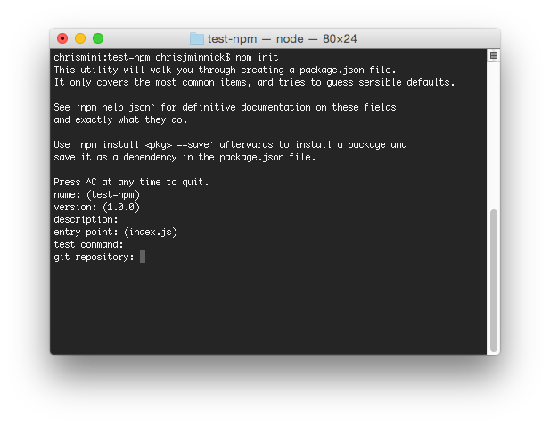
Lab – Initialize npm
Notes:
npm stores information about the packages installed in your project in package.json. Run npm init to create a package.json file.

Slide 406
node_modules
Two ways to install npm packages
Locally
Globally
When you install packages locally, they're put into the node_modules directory in your current directory.
You should always run npm install from the same directory as your package.json file, which should be at the root of your project.
Run npm update to update local packages
Run npm outdated to find out which packages are outdated.
Notes:
Important note: This isn't an issue at this point, but if you're working on Windows, you're going to run into a problem sooner or later. Modules that have long chains of dependencies can create long file paths, which can break on Windows. Running npm dedupe usually fixes the problem. Other possible solutions: http://gsferreira.com/archive/2015/07/reduce-the-path-length-of-a-node-js-project/

Slide 407
package.json
Manages locally installed npm packages
Documents packages your project depends on
Specifies the versions of each package your project can use
Makes your build reproducible
Package versions are specified using Semantic versioning (semver)
Semver ranges:
~ : patch release - 1.0.x
^ : minor release - 1.x
* : major release - x

Slide 408
npm Install
Is used to download and install a package
-g: install globally
--save: Package will appear in your dependencies
--save-dev: Package will appear in your devDependencies
--save-optional: Package will appear in your optionalDependencies
--save-exact: Saved dependency will be configured with an exact version rather than the default range operator.

Slide 409
Lab – Using npm as a Build Tool

Slide 410
Static Code Analysis
Objectives
Learn about Lint tools
Use ESLint
Configure ESLint
Manual testing with a local web server

Slide 411
Lint tools
JSLint
Created by Douglas Crockford
Highly opinionated (like Mr. Crockford)
Flags style that conflicts with "The Good Parts" according to D.C.
JSHint
More control
Doesn't flag style issues by default
ESLint
Allows developers to create their own rules ("Pluggable")
"Agenda free" - doesn't promote any particular style
Notes:
Linting tools look at your code and look for errors and bad practices.
The first linting tool for JavaScript is JSLint, which was created by Douglas Crockford.
JSLint flags a lot of style issues that Crockford thinks are bad.
JSHint was created in order to give more control over which style issues are checked for.
ESLint is a new tool that is highly customizable and features plugins for many different styles, libraries, and frameworks -- including React and JSX.

Slide 412
Configuring ESLint
Two ways
Configuration comments
embed configuration info in JS files with comments
/* eslint eqeqeq: "off", curly: "error" */
Configuration files
.eslintrc file

Slide 413
ESLint: What Can Be Configured?
Environments
Where is the code running?
Includes predefined global variables for each environment.
Globals
Specify additional globals your scripts use.
Rules
Enable rules at different levels.

Slide 414
ESLint Rules
3 Levels
"off" or 0
Rule not applied.
"warn" or 1
Warn but don't exit.
"error" or 2
Error and exit.
Example rules
{ "rules": { "eqeqeq": "off", "curly": "error", "quotes": ["error", "double"] } }

Slide 415
Lab 7 - Automate Linting
Install ESLint into project
Test it
Create an npm script called "lint"
Make lint task a dependency of default build task

Slide 416
Lab - Managing External Dependencies
Create a script called version-check to check the node version
Compare node version against version listed in package.json
Fail with helpful message if wrong version is installed
Make the default task dependent on version

Slide 417
Chapter 6: Building and Refactoring
Objectives
Use Webpack to build your production files
Integrate Webpack into the automated build

Slide 418
Building the dist directory
Use webpack to bundle everything
Use babel to convert ES6 code to ES5
Use run webpack and create the dist directory.

Slide 419
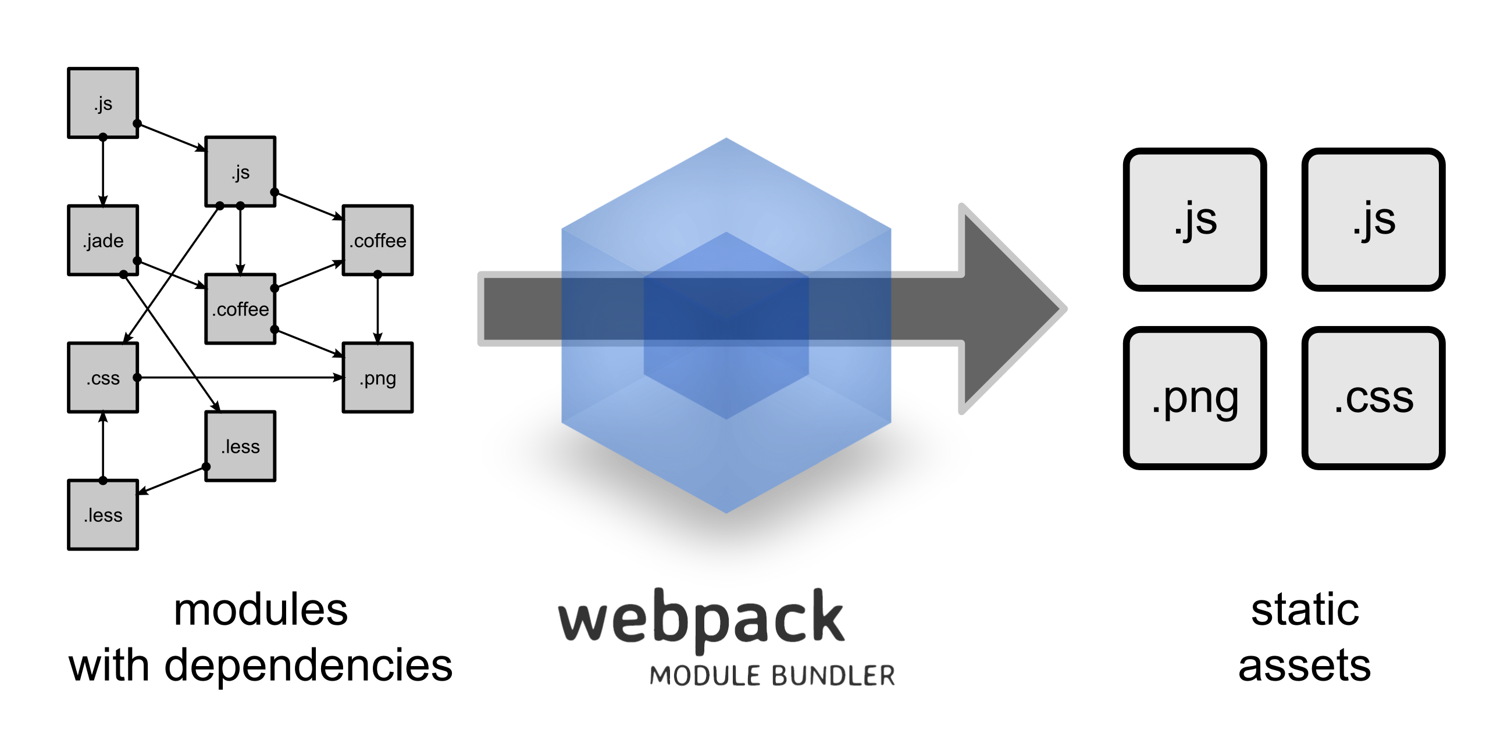
webpack

Slide 420
How webpack Works
Treats all assets as modules.
Loads modules using most module styles (CommonJs, AMD, ES6) and creates a 'bundle'.
Uses loaders to transform non-JS resources into JS
Loaders transform individual files
Plugins extend webpack's capabilities
Plugins work on the entire bundle

Slide 421
Lab: Deploying with Webpack
Notes:
Now that we have automated linting and testing, the next step is to automate the building of what will actually go on the server. You never want to serve your source files directly. You need to process them, minify them, and bundle them first. You can automate this process with webpack

Slide 422
Thank You
chris@minnick.com
https://chrisminnick.com

Slide 423
Disclaimer and Copyright
Disclaimer
WatzThis? takes care to ensure the accuracy and quality of this courseware and related courseware files. We cannot guarantee the accuracy of these materials. The courseware and related files are provided without any warranty whatsoever, including but not limited to implied warranties of merchantability or fitness for a particular purpose. Use of screenshots, product names and icons in the courseware are for editorial purposes only. No such use should be construed to imply sponsorship or endorsement of the courseware, nor any affiliation of such entity with WatzThis?.
Third-Party Information
This courseware contains links to third-party web sites that are not under our control and we are not responsible for the content of any linked sites. If you access a third-party web site mentioned in this courseware, then you do so at your own risk. We provide these links only as a convenience, and the inclusion of the link does not imply that we endorse or accept responsibility for the content on those third-party web sites. Information in this courseware may change without notice and does not represent a commitment on the part of the authors and publishers.
Copyright
Copyright 2021, WatzThis?. All Rights reserved. Screenshots used for illustrative purposes are the property of the software proprietor. This publication, or any part thereof, may not be reproduced or transmitted in any form by any means, electronic or mechanical, including photocopying, recording, storage in an information retrieval system, or otherwise, without express written permission of WatzThis, 567 Commercial St, Astoria, OR 97103. www.watzthis.com
Help us improve our courseware
Please send your comments and suggestions via email to info@watzthis.com

